Slide 1
Time Series – The nature of time series 1b
Cynthia Rudin | Computer Science and Electrical and Computer Engineering, Duke

Slide 2
Where do time series arise?
Financial data (stocks, currency exchange rates, interest rates)
Click-through rates
Sales forecasts
Demand forecasts
Natural phenomenon (water flow, temperature, precipitation, wind speed, animal species abundance, heart rate)
Notes:
*1* that one’s clear
*2* ctr – Ctr are essentially the markers of people’s interest and attention when they are browsing the internet. Everyone wants to know how many people will click, when they are likely to click, and so on. Whether it’s for advertising, or just showing them some useful information, or whatever
*3* sales forecasts – in order to decide how many products to stock, we need to forecast sales, which comes over time
*4* energy companies have to forecast demand for the next day in order to figure out how much energy to produce.
*5* perhaps you could try to predict water flow at a particular location, or perhaps you want to study earthquakes, or temp, or precipitation *read*
There are a huge amount of possible applications for time series analysis.

Slide 3
What might you want to do with time series?
Smoothing – try to recover an underlying series from a noisy one.
Modeling – try to explain how the time series arose
Models can be useful for intervention.
Forecasting – try to predict the values of the time series in the future
Notes:
What might you want to do with a time series? There are a lot of useful things people do. For instance, smoothing. Maybe you have a very wiggly signal and you would like to be able to see the trend in the signal better and not see the noise so much. Or maybe you would like to do modeling, where you might ask how the time series arose? In other words, what could lead to a time series like this? For instance, you might say - *this* time series of sales comes from a weekly pattern, plus a slowly time varying trend, plus a stationary noise signal.
These models can be useful for intervention. If you know what the time series is caused by, you might be able to change it. For instance, if you know the dairy time series changes based on a weekly pattern, then if you can interrupt or remove that pattern, and you can predict what would have happened to the time series if you made that change.
Or you could do other kinds of forcasting, where you try to predict the values of the time series in the future.
Have all this structure, we want to exploit it by modeling it. Any useful prior knowledge we can put in can help us. And that’s what we’re going to talk about today.

Slide 4
Autocorrelation in Time Series

Slide 5
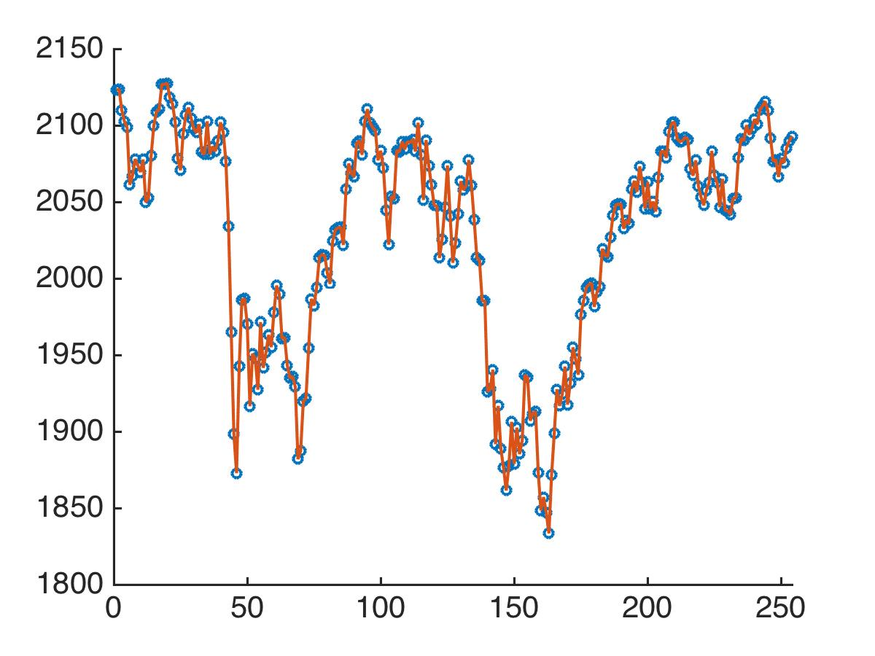
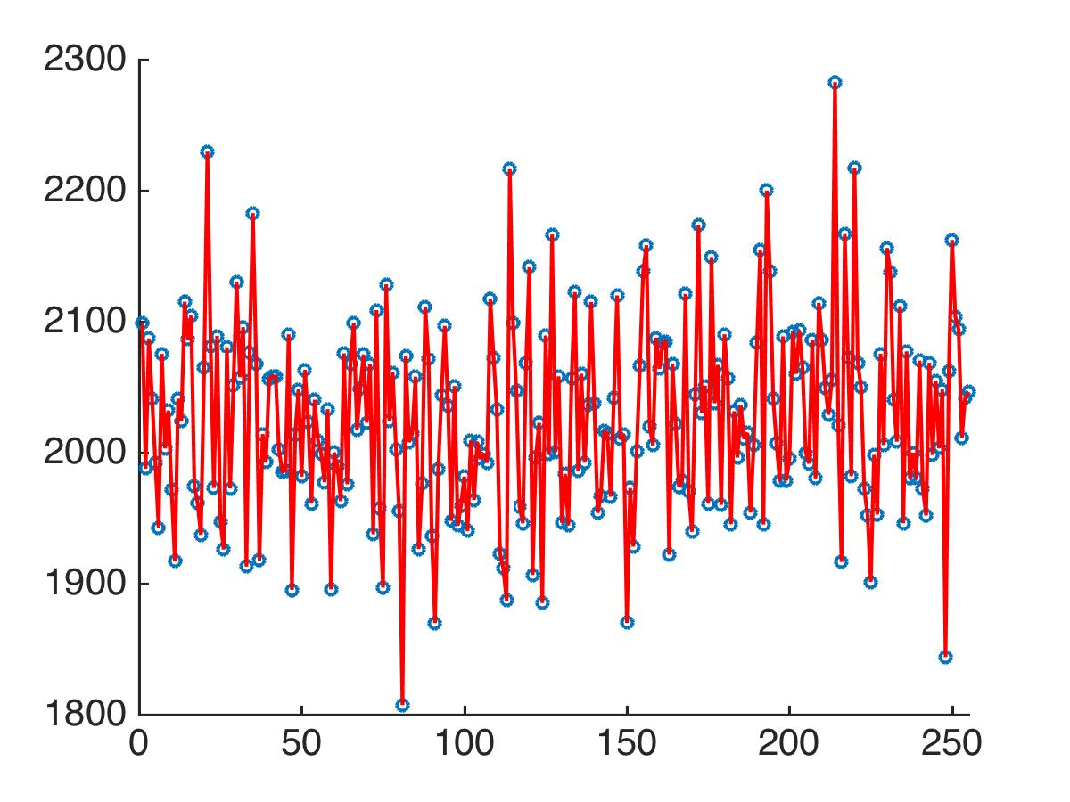
Time Series Have Specific Characteristics
Which one of these is S&P 500 index over a year vs. time?
6/23/2015
6/23/2016
6/23/2015
6/23/2016
Notes:
Time series don’t have the same characteristics as independent random numbers. For instance, if I told you that one of these two plots was independent random numbers, and the other was a plot of the S&P 500 over the course of a year, could you guess which one was which? *click* I suppose you wouldn’t have any trouble with that, right?

Slide 6
Time Series Have Specific Characteristics
Which one of these is S&P 500 index over a year vs. time?
S&P 500
Random Noise
6/23/2015
6/23/2016
6/23/2015
6/23/2016
Notes:
So this one obviously is the S&p500 and this one is just normal random noise. Now obviously you couldn’t make predictions for normal random noise since each point was generated separately from all the other points. But could you make predictions for the S&P500?

Slide 7
Time Series Have Specific Characteristics
Which one of these is S&P 500 index over a year vs. time?
S&P 500
Random Noise
Can I Predict?
6/23/2015
6/23/2016
6/23/2015
6/23/2016
Notes:
If you’re here on this date, and you want to predict the next point, could you do it?

Slide 8
Time Series Have Specific Characteristics
Which one of these is S&P 500 index over a year vs. time?
S&P 500
Random Noise
Can I Predict?
6/23/2015
6/23/2016
6/23/2015
6/23/2016
Notes:
Say you can’t see what happens next. Can you predict what’s going to happen? And the answer is probably. For most days.
But here with the random noise, no you can’t predict. The signal could be anywhere. There’s no periodicity, there’s no pattern, no trend, just random numbers. So you can’t predict. The fact is - that the S&P 500 values in the future are correlated to the values in the past, which is why you can predict.

Slide 9
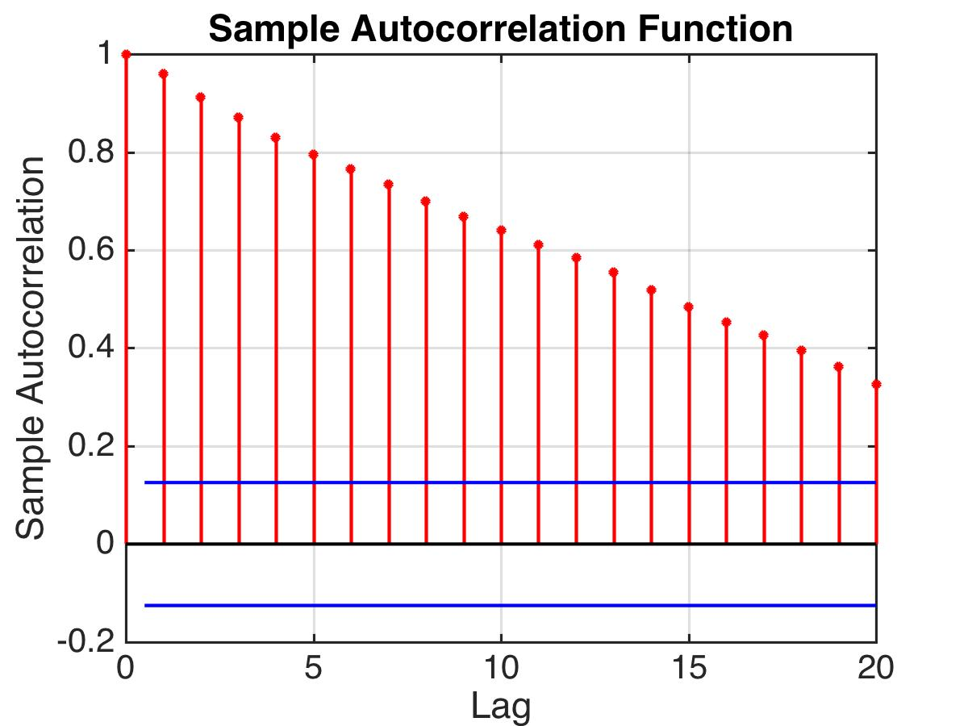
Time Series Have Specific Characteristics
S&P 500
6/23/2015
6/23/2016
Notes:
Now what I’m showing you here is the autocorrelation function for the S&P500 data. I’ll explain more about what that function is, but what it shows is how correlated the present is with the past.

Slide 10
Notes:
click

Slide 11
This means the value at time t is highly correlated with the value at t-1

Slide 12
This means the value at time t is highly correlated with the value at t-2
(but not as much)

Slide 13
Even 20 time steps behind we still know something about the value at t.
Notes:
*Read* That’s not true with the normal random draws, for those this plot would just be 0. And that’s just the nature of the data we’re working with.

Slide 15
Time Series Can Be Decomposed

Slide 16
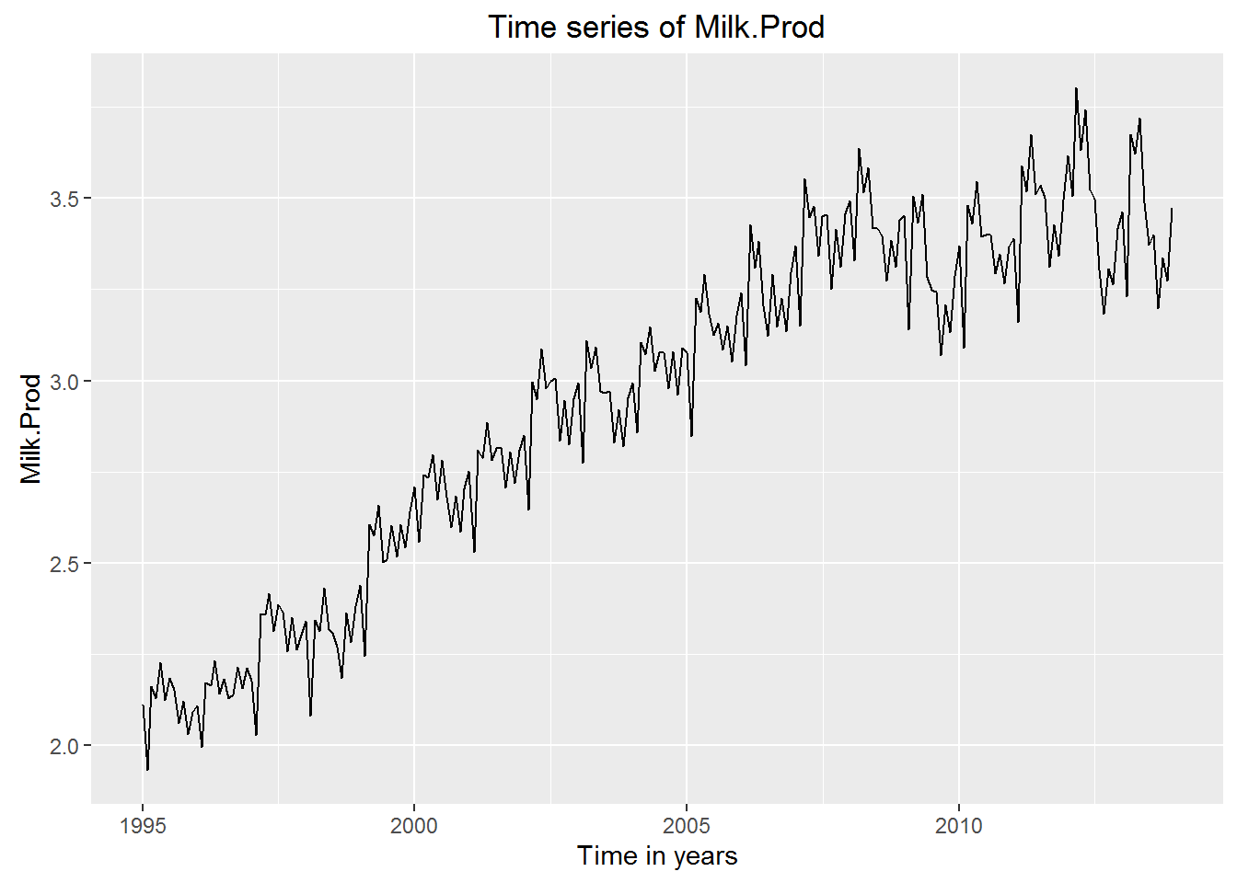
Milk Production
1995
2015
Time in Years
How to model this?
Notes:
This is a plot of milk production over the course of 20 years. So how are we going to model this? To me this when I see this, I see an overall trend. Do you see it?

Slide 17
Milk Production
1995
2015
Time in Years
How to model this?
Notes:
Kind of like that. Now besides the trend, what’s left?

Slide 18
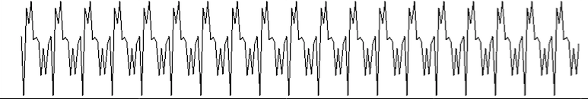
Milk Production
+ Stationary
Signal
Pattern
How to model this?
Notes:
I think, we would decompose the signal into the trend, plus a periodic signal buried in there *click*, and also some kind of stationary signal that looks like noise *click*. By periodic, I mean something that repeats. And by stationary, I mean something whose mean and variance doesn’t change over time. Stationary signals can also have specific structure, and we’ll talk a lot more about it as we go on. *pause* It’s nice that we could decompose this signal into these three big components, the trend, the pattern, and the stationary signal. Once you get rid of the obvious stuff like the trends and the repeating pattern, then you just have the stationary signal and modeling gets a bit harder as you try to squeeze the most information out of these data.

Slide 19
Irregular reporting

Slide 20
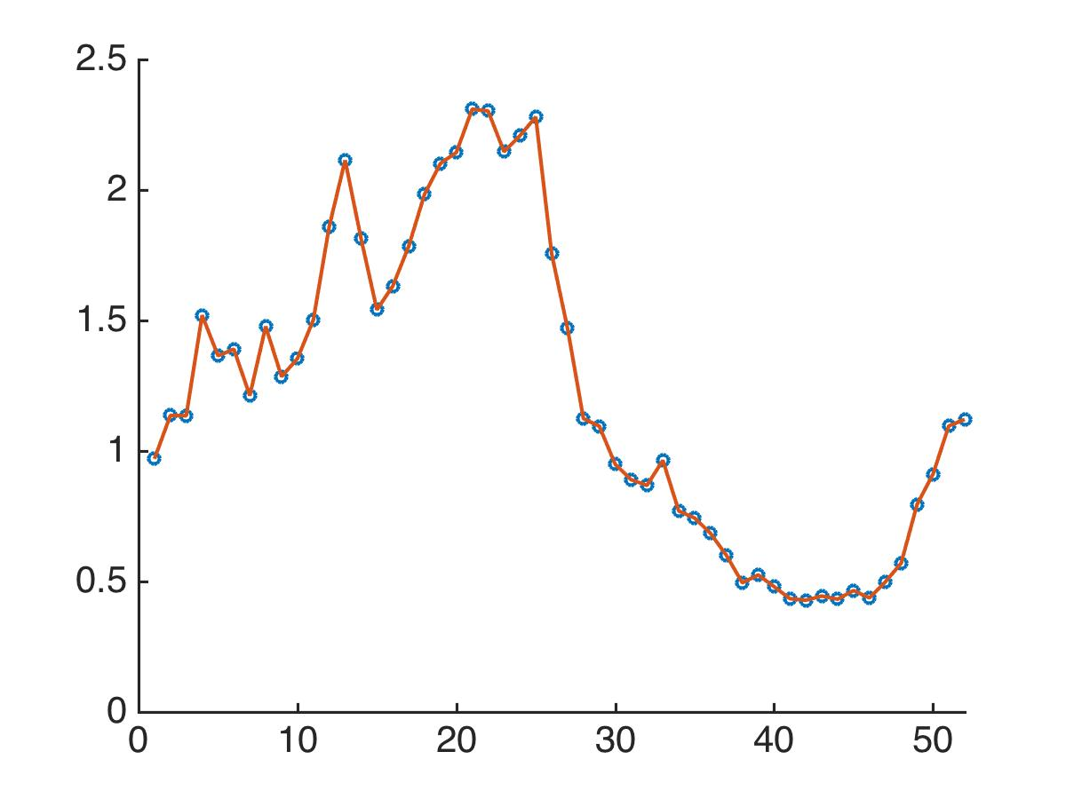
Time Series Have Specific Characteristics
Percent of individuals searching for flu symptoms on the Internet in the North East US.
10/9/2005
10/1/2006
Notes:
This is a plot of the *read* between oct 2005 and 2006. And the reporting times are pretty regular, especially in here. *point* But what if the reporting times weren’t so regular? Then you could be missing quite a lot of data.

Slide 21
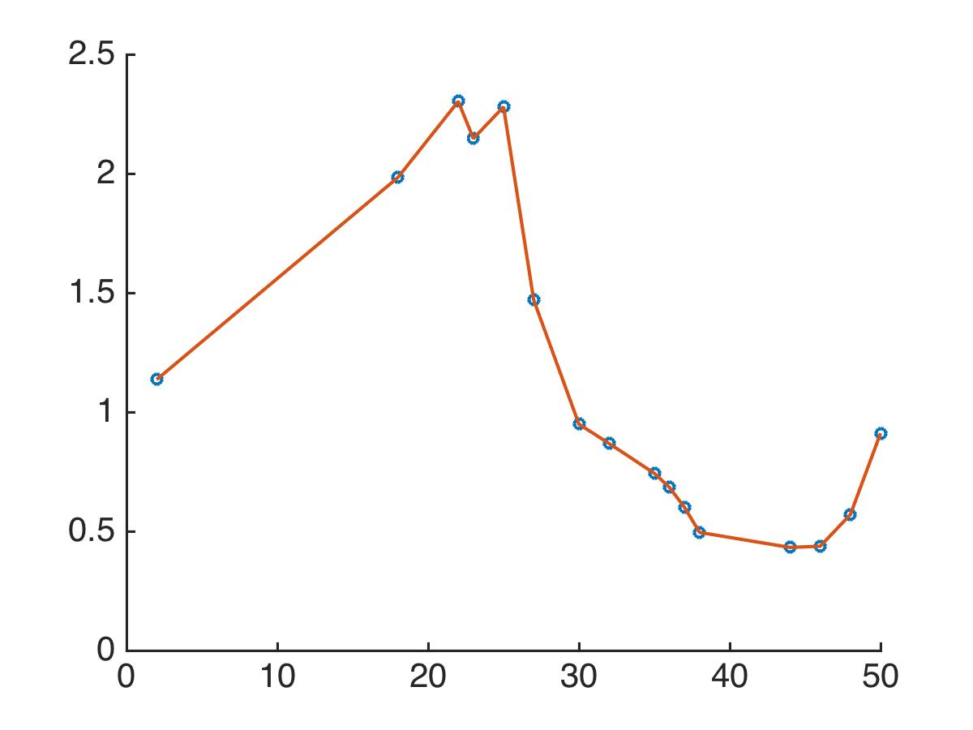
Time Series Have Specific Characteristics
Percent of individuals searching for flu symptoms on the Internet in the North East US, irregular reporting
10/9/2005
10/1/2006
Notes:
So here for instance we’re missing a lot of measurements. And this could really cause problems with a lot of techniques. I have to warn you that a lot of what we’ll be talking about going forward assumes regular reporting times. Some of the most important techniques can work with irregular data, but I need to warn you that you might run into this.

Slide 22
Time Series – trend, seasonality 1d
Cynthia Rudin | Computer Science and Electrical and Computer Engineering, Duke

Slide 23
Decomposition of Time Series
Notes:
The goal is to take the time series, and decompose it into pieces. There might be a general trend, a repeating pattern, and one of the pieces should be stationary. Let’s do an example.

Slide 24
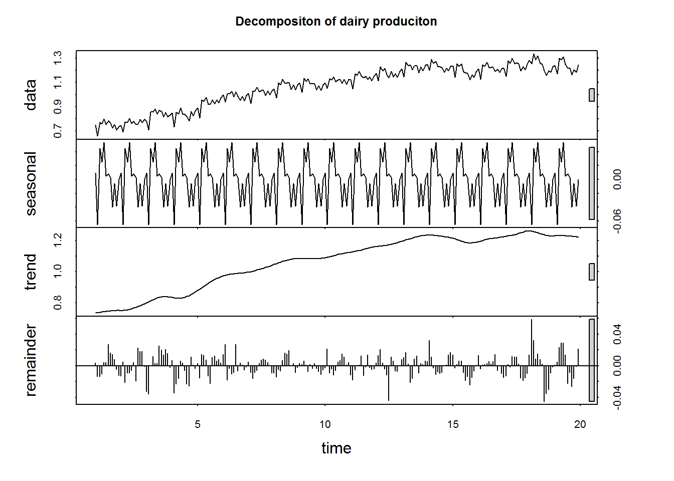
Milk Production
Notes:
Just to give you a little preview, let’s go back to the milk production data I showed you earlier. We can decompose it into 3 pieces, the general trend, the periodic pattern, and whatever is left, which we hope is stationary.

Slide 25
Milk Production
Notes:
here’s the periodic pattern

Slide 26
Milk Production
Notes:
Here’s the general trend

Slide 27
Milk Production
Notes:
And there’s the rest. Now how in the world do we do that automatically?

Slide 28
Milk Production
Notes:
First things first. How do we get that trend. Say you had the full signal up top, and you want to find that trend so you could subtract it and look at what’s left. One of the key tools for doing this is lowess regression. It’s a smoothing technique. So let me tell you how that works next.

Slide 29
Lowess/Loess Regression

Slide 30
Lowess/Loess Regression
Lowess – locally weighted scatterplot smoother
Loess – local regression
They are essentially the same thing.
Idea: fit local polynomial models and merge them
Notes:
*read 2 click* the idea is to fit local polynomials to the data and then merge those polynomials together to form a full model. That keeps the model nice and smooth because they are polynomials, but it also keeps the model flexible because it can fit locally. So here goes.

Slide 31
Lowess/Loess Regression
Step 1: Define the window width m. We will use the m nearest neighbors that are within the window to do local regression.
Step 2: Choose a weight function. It should give higher weights to nearer points.
m points in window
window width
Notes:
*read* so let’s plot time on the horizontal axis. *click* Let’s say we’re working on this point which is at the center there, we’ll call it t0 – that’s just where the center is. *click*. And then the time series values are going to be called x *click* on the vertical axis. *click* there’s my time series. *click* there’s a window, and this is its width *click*. We’re not going to use the points outside of the window so let’s remove them for now *click*. There are m points in the window. that was the first step, now on to step 2. *click, read* *click* because when we do our fitting *click*, we want to fit the points nearer to the center more closely. So what are we going to choose as the weighting function? We need something that is large around t0 and smaller farther out.

Slide 32
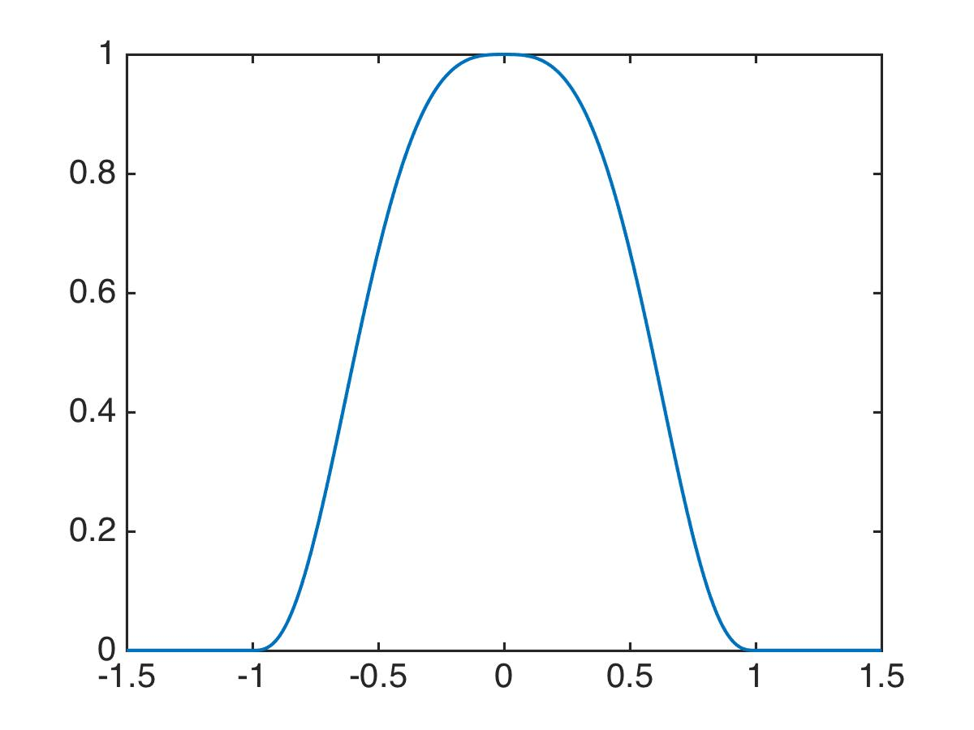
Lowess/Loess Regression
Step 1: Define the window width m. We will use the m nearest neighbors that are within the window to do local regression.
Step 2: Choose a weight function. It should give higher weights to nearer points.
Notes:
Here’s the weighting function we’re going to use. As you can see, it’s large at t0 and decays farther out. The function uses the distance between t and t0. Normally I’d just use absolute value of t-t0 but it’s a little more complicated. The distance is normalized so that the distance to the edge of the window is 1. All the distances are scaled so that the maximum distance is 1. Let me be more precise about exactly what that formula is, though it’s in the computer already so you don’t need to program it yourself. But I”ll write all the math out so that you could program it yourself if you wanted to.

Slide 33
Lowess/Loess Regression
tri-weight function:
Notes:
So there’s the formula. Outside the window it’s 0, inside it’s this function here which makes a nicely shaped bump. Remember, all the distances are scaled. I haven’t written that part in the math yet, so let me do that.

Slide 34
Lowess/Loess Regression
tri-weight function:
scaled distance to neighbor i is:
weight for neighbor i is:
distance from center
scaled
Notes:
The scaled distance to neighboring point i looks like this, where yes we do have the difference between the time for neighbor i and t0 but we also have it scaled by the width of the window. So the whole formula for the weight looks like this. You take the scaled distance u_i, then send that through the tri-weight function and that’s the weight.

Slide 35
Lowess/Loess Regression
Step 1: Define the window width m. We will use the m nearest neighbors that are within the window to do local regression.
Step 2: Choose a weight function. It should give higher weights to nearer points.
m points in window
window width
Notes:
So we compute the weights *clicks* and now we’re going to do the fitting.

Slide 36
Lowess/Loess Regression
Step 1: Define the window width m. We will use the m nearest neighbors that are within the window to do local regression.
Step 2: Choose a weight function. It should give higher weights to nearer points.
Step 3: Do regression. Use polynomial terms. Use the weights from Step 2.
Notes:
For this we’re going to use regression. We’ll use polynomial terms so that we get a nice smooth curve. And we use the weights from step 2 to do the fitting so that we fit the nearby points more closely. Let me tell you about that.
http://polisci.msu.edu/jacoby/icpsr/regress3/lectures/week4/15.Loess.pdf

Slide 37
Taylor’s theorem from calculus:
Notes:
We start with taylor’s theorem from calculus which is right there. We could use more terms if we want, but let’s just go with quadratic and linear terms. Taylor’s theorem tells us how good of an approximation this is. So now we’ve approximated our time series by a quadratic. The question is *which* quadratic. We have to estimate the betas. We’ll use the method of least squares to compute the estimates of the betas. *click* The weights tell us to ignore points outside the window, because their weight is 0, and it tells us to fit the curve more closely to the points with higher weights that are close to x0. And of course the function we’re trying to fit with least squares is that quadratic *click* that comes from taylor’s formula. The least squares procedure is very simple, it’s just a matrix inverse and a matrix multiplication, so you should assume that we now have the beta hats.

Slide 38
Taylor’s theorem from calculus:
Notes:
Now… let’s get an estimate at the point t0. Of course we’re going to call the estimate x0hat. So if we take the formula we have for estimating values of x, and we set ti equal to t0, then both of these terms disappear and we are left with beta0 hat. And that’s it. That’s how we get a regression estimate for each time. And we just repeat this whole procedure for each time.

Slide 39
Lowess/Loess Regression
Step 1: Define the window width m. We will use the m nearest neighbors that are within the window to do local regression.
Step 2: Choose a weight function. It should give higher weights to nearer points.
Step 3: Do regression. Use polynomial terms. Use the weights from Step 2.
Repeat these steps for each value of t.
Notes:
So there are the steps again. First define the window width. Then choose the weight function, basically just choose the triweight function. Then do regression with linear and quadratic terms, using the tri-weight function, then get an estimate for the point you’re at and repeat that for any point you wish. That’s it.
http://polisci.msu.edu/jacoby/icpsr/regress3/lectures/week4/15.Loess.pdf

Slide 40
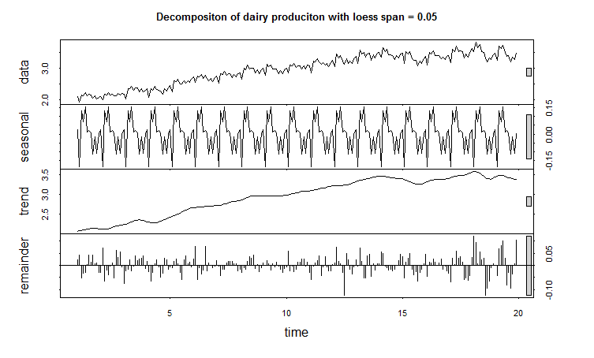
Adjusting the window width
window includes
5% of the data
Notes:
The one thing I have to warn you about are the fiddly parameters. In loess regression, you have to choose the window width. So here the width included 5% of the data. So m was 5% of the data. But you can change that. But when you do that, things change. If you use more of the data in the window, the trend will get flatter, and then the residual will get bigger too.

Slide 41
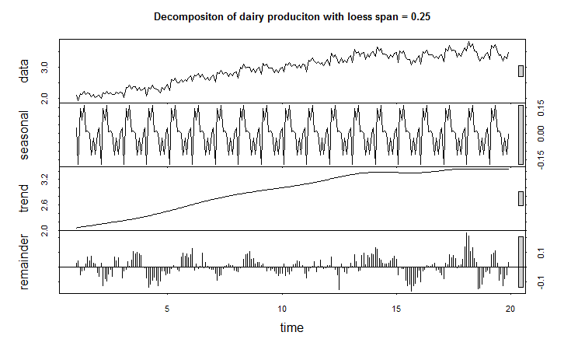
Adjusting the window width
window includes
25% of the data
Notes:
here it’s a quarter of the data. See the trend is much flatter, so there’s more of the signal in the residual.

Slide 42
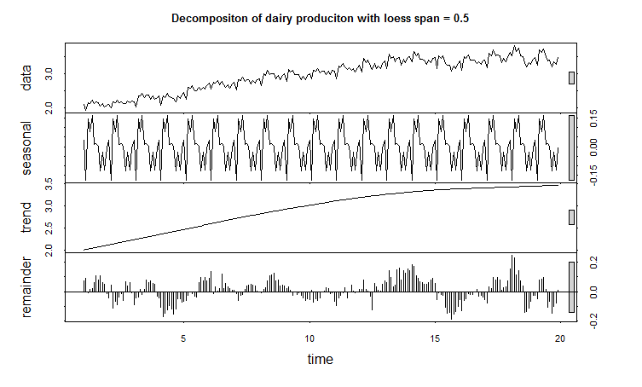
Adjusting the window width
window includes
50% of the data
Notes:
here it’s half the data. Again, smoother trend, and more residual

Slide 43
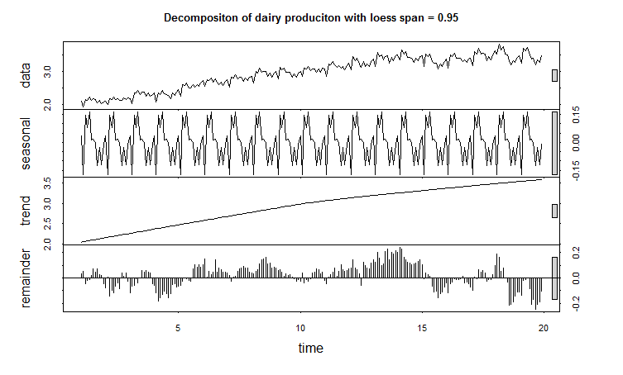
Adjusting the window width
window includes
95% of the data
Notes:
There it’s 95% of the data

Slide 44
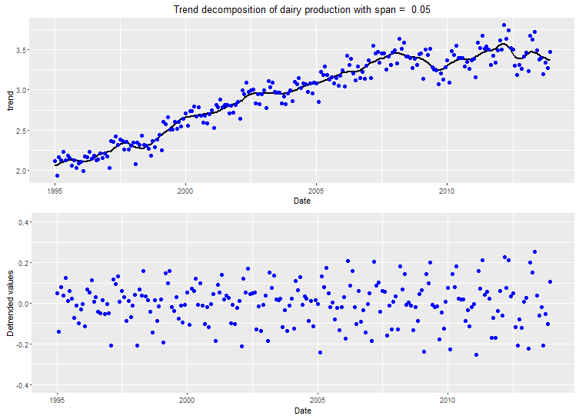

Slide 45
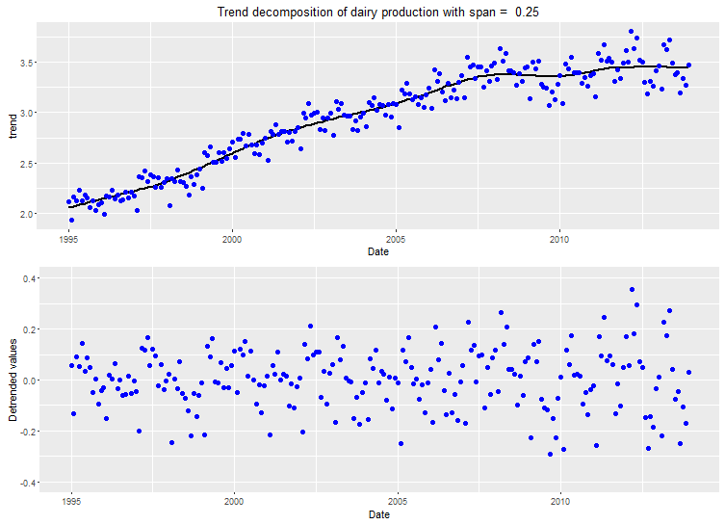

Slide 46


Slide 47
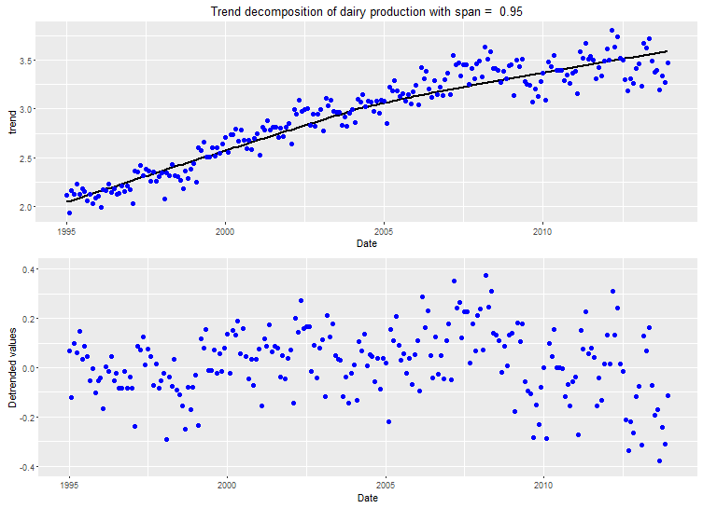

Slide 48
Notes:
And that’s it.

Slide 49
Moving Average Smoothing
Notes:
Let’s assume we’ve done loess and got that taken care of, so now we can see the trend.

Slide 50
Milk Production
Notes:
Ok so now we’ve got the trend, or something close to it. What we’re supposed to do is subtract that out and see what’s left. It should be a periodic signal that’s maybe a little noisy. Our job is then to remove the periodic stuff so we can get to something that is stationary. We know how to remove the large scale trend, but now we need to remove the periodic stuff on a more fine-grained scale.

Slide 51
Another way to remove an obvious periodic signal
Use a low-pass filter (moving averages).
Notes:
Loess removes big trends, this we will use for removing smaller periodic stuff. We’ll remove seasonality on a more fine-grained level. And it’s a low pass filter, called moving averages.

Slide 52
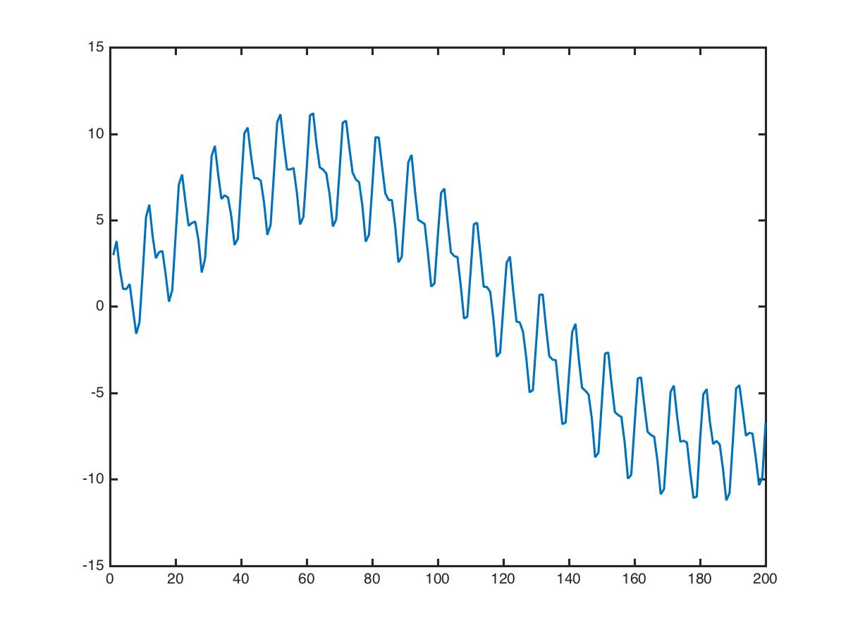
Low-pass filtering (moving averages)
Show by example. Start with a signal that clearly has some periodicity.
10
(The truth: this signal is the sum of two periodic signals with different periods, plus noise)
Notes:
So I’ll show you this by example. We’ll start with a signal that clearly has some periodicity. The period is length 10. *click* We’re going to try to decompose this into a periodic piece and a long term trend. (I will be honest and tell you that this particular signal is composed of two periodic signals + a drop of noise just for fun, so we should be able to recover the two signals and the noise if we do this right.)

Slide 53
Low-pass filtering (moving averages)
Show by example. Start with a signal that clearly has some periodicity.
Average these 10 values to get this
(The truth: this signal is the sum of two periodic signals with different periods, plus noise)
Notes:
The method of moving averages is super simple. You just average the previous 10 values to get a smoothed estimate for the current time. So to get this point right there, we’ll just average the previous 10 values *click* *repeat*

Slide 54
Low-pass filtering (moving averages)
Show by example. Start with a signal that clearly has some periodicity.
Average these 10 values to get this
(The truth: this signal is the sum of two periodic signals with different periods, plus noise)
Notes:
And then we’ll continue to move everything over and use the next 10 values to get the estimate for the next point.

Slide 55
Low-pass filtering (moving averages)
Show by example. Start with a signal that clearly has some periodicity.
Average these 10 values to get this
(The truth: this signal is the sum of two periodic signals with different periods, plus noise)
Notes:
And so on.

Slide 56
Low-pass filtering (moving averages)
Show by example. Start with a signal that clearly has some periodicity.
Average these 10 values to get this
(The truth: this signal is the sum of two periodic signals with different periods, plus noise)
Notes:
And we can trace out the whole curve this way. *click* The formula for the estimate just looks like this *click* it’s the average of the previous c points, where c is the periodicity of the signal. If you choose c wrong, you could mess it up. Here we assume we know the periodicity of the signal.

Slide 57
Low-pass filtering (moving averages)
Show by example. Start with a signal that clearly has some periodicity.
Notes:
So what happens when you do moving averages? doesn’t quite work on the first try.

Slide 58

Low-pass filtering (moving averages)
Show by example. Start with a signal that clearly has some periodicity.
What if we subtract the moving average?
Moving Average with
period c=10
10
Notes:
let’s subtract out the moving average and see what’s left.

Slide 59
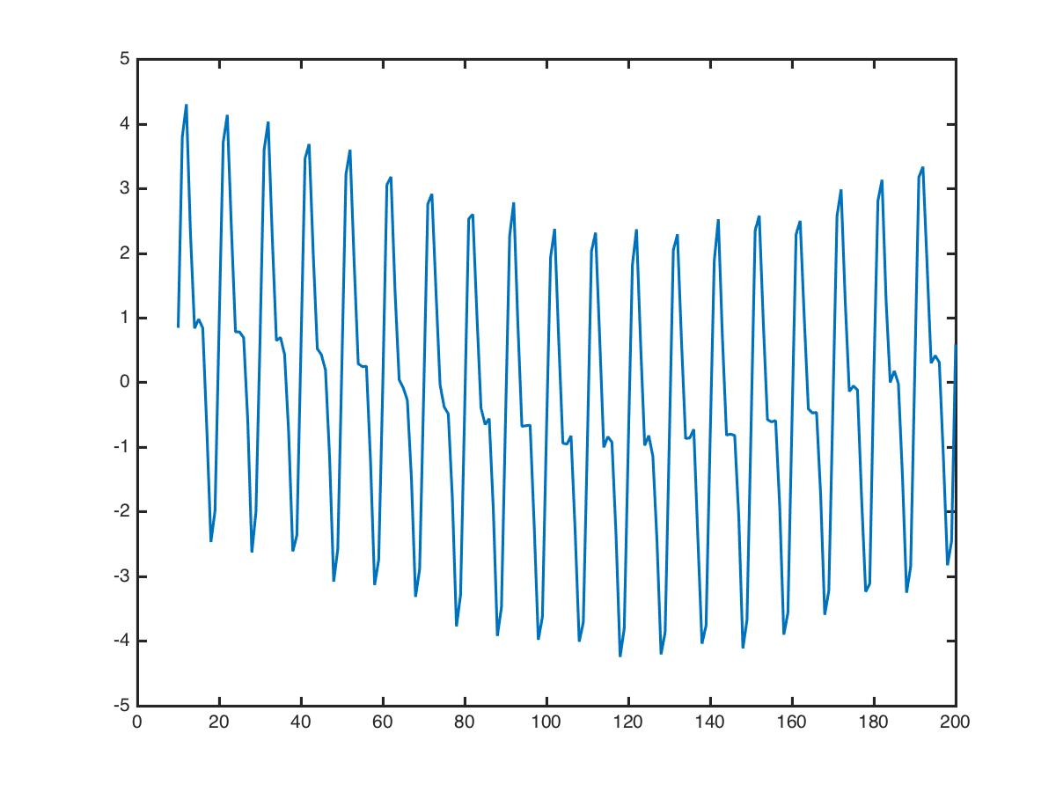
Low-pass filtering (moving averages)
Show by example. Start with a signal that clearly has some periodicity.
Moving Average with
period c=10
10
Data – Moving Average
Notes:
And we get that. But there’s still a trend in it.

Slide 60
Low-pass filtering (moving averages)
Show by example. Start with a signal that clearly has some periodicity.
10
Data – Moving Average
Notes:
It’s pretty good, most of the signal is the pattern, but still, we could do better.

Slide 61
Low-pass filtering (moving averages)
Data – Moving Average
10
10
Notes:
So since there’s still more signal, let’s just do moving averages again.

Slide 62
Low-pass filtering (moving averages)
Average these 10 values to get this
Notes:
Same thing as before, same formula as before.

Slide 63
Low-pass filtering (moving averages)
Data – Moving Average
10
Notes:
And what does our new trend look like?

Slide 64

Low-pass filtering (moving averages)
Data – Moving Average
10
10
Notes:
Looks like this. Now we’re cooking.

Slide 65
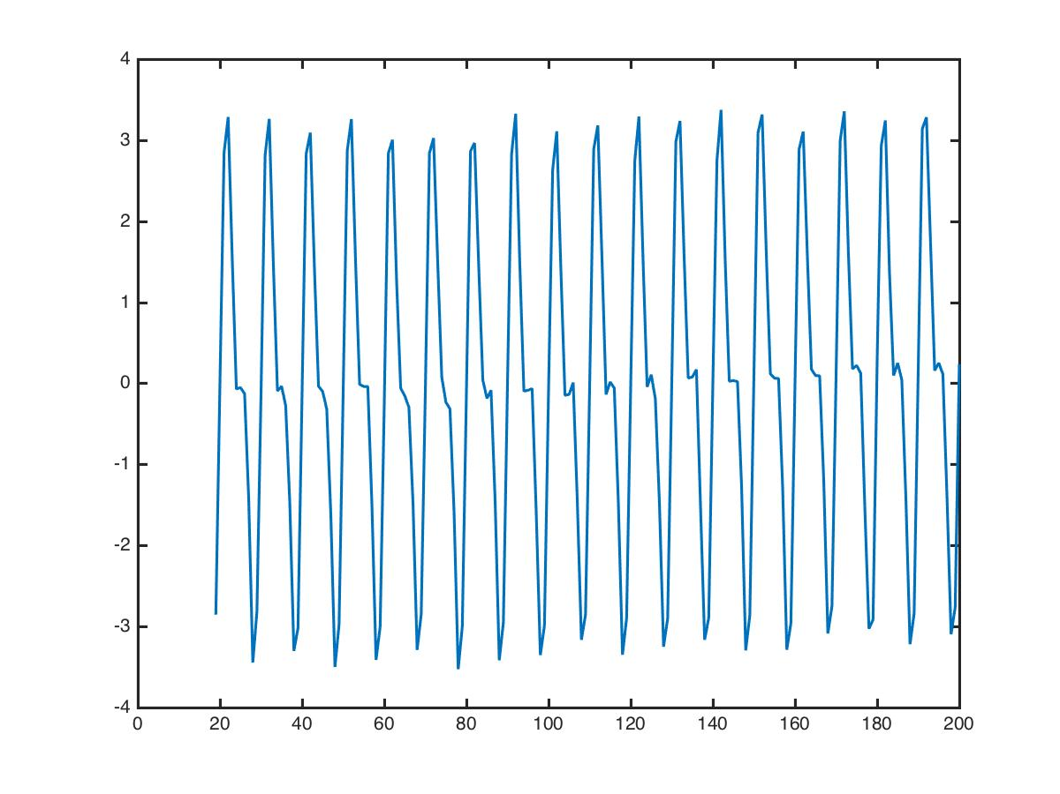
Low-pass filtering (moving averages)
Data – Moving Average
Data – Moving Average – Moving Average
Notes:
Let’s take that trend out. And *click* what we’re left with is this. Very nice and periodic.

Slide 66
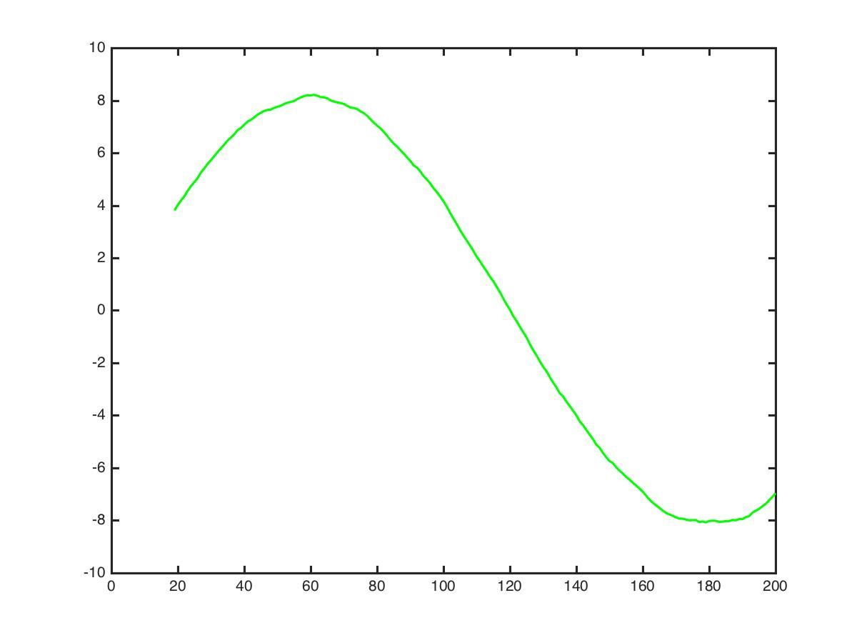
Low-pass filtering (moving averages)
Moving Average + Moving Average
Data – Moving Average – Moving Average
Notes:
And we also have the lovely periodic trend too. We did moving average twice, so we can add up the trends we got from doing it twice, and that’s the green curve.

Slide 67
Data
||
Trend
+
Periodic
Notes:
So we got the decomposition, which is trend plus periodic trend. *click* very nice.

Slide 68
STL

Slide 69
So far
Loess – find trends using local polynomial modeling.
Need to determine bandwidth parameter.
Coarse, looks at data over possibly many cycles.
Moving Average smoothing – find trends by averaging over one cycle length.
Won’t work well if the trend is not smooth.
Need to know the cycle length.
Fine-grained, looks only at the previous cycle, nothing else.
Notes:
So far, we’ve discussed 2 techniques. Loess, which uses polynomial smoothing. You get to determine the window width. This is for coarse trends and looks at data over possibly many cycles.
Moving averages is for more fine grained smoothing. It works by averaging over one cycle length. And since it uses averages, it assumes that the trend is smooth. You have to know the cycle length in advance for moving averages. And it uses the previous cycle but nothing else. It’s not going to give you a long term polynomial fit to lots of data, like loess.
Both are useful, and I’m not going to say one is better than another. The stl package uses both of these repeatedly for decomposing the signal. One nice thing about moving averages is if you know the cycle length, you don’t need to figure out the bandwidth for the polynomial, which is a pain and could cause you to mess it up if you don’t know what the right bandwidth is. But again it’s just averages so you’re not getting a full blown polynomial model like you’re getting with loess. Allright, so now I’m going to talk about the stl package.

Slide 70
STL package (abbreviated)
Use Loess to find a general trend T.
Subtract it: X-T.
Use Moving Average Smoothing to find more trend C.
Subtract it: S=X-T-C
The seasonal component remains, called S.
Smooth the total trend X-S with Loess to get total trend V
The remainder is R=X-S-V.
Notes:
The full package is pretty complicated. You can read the manual if you like. I read it. There are a lot of calculations that go into this, this is a real feat of engineering here. Anyway, so here’s an abbreviated version of what it does.
*click* It uses loess to find a general trend T. Then it gets rid of it.
*click* You should be left with something almost periodic.
*click* Then use MA to get the rest, a more fine-grained trend. Called C.
*click* then you get rid of that trend too. What’s left is the seasonal component
*click* called S. It’s seasonal because you smoothed out all the stationary stuff, so that’s gone, and you subtracted out the trend, so that’s gone, so all that’s left is the periodic stuff. So we call that S.
*click* Now you take the seasonal signal and you remove it from the original data and what you’re left with is the sum of the two trends you found before. X-S is the same as T+C *point to equation*. So this thing *point down* is the sum of the two trends. Then you take those trends, and smooth it out with loess. What you’re left with is a nice smooth trend called V. Now
*click* if you take the original signal, take out the seasonal component, and take out the nice smooth trend, you’re left with the remainder. And that’s the magic behind STL.
What remains is

Slide 71
Milk Production
Notes:
When I first saw STL I was really impressed. It is really good at decomposing signals like this. And I was wondering what magic was behind there. So now you know!
Ok - On to dealing with the remainder.

Slide 72
Stationarity

Slide 73
Stationarity
Stationary time series have no trend.
Second-order stationarity conditions:
Constant Mean
Constant Variance
An autocovariance that does not depend on time
Let’s check the first two conditions graphically.
Notes:
After we have gotten rid of big huge trends and obvious periodicity and things like that, it’s time to pull out another bag of tricks. Hopefully we’re dealing with a stationary time series. But what does that mean? It means time series have no trend. They obey the second order stationarity conditions. They have a constant mean over time, a constant variance, and an autocorrelation/autocovariance function that doesn’t depend on time.
I’ll explain what autocovariance is shortly. For now, let’s check the first two conditions graphically.

Slide 74
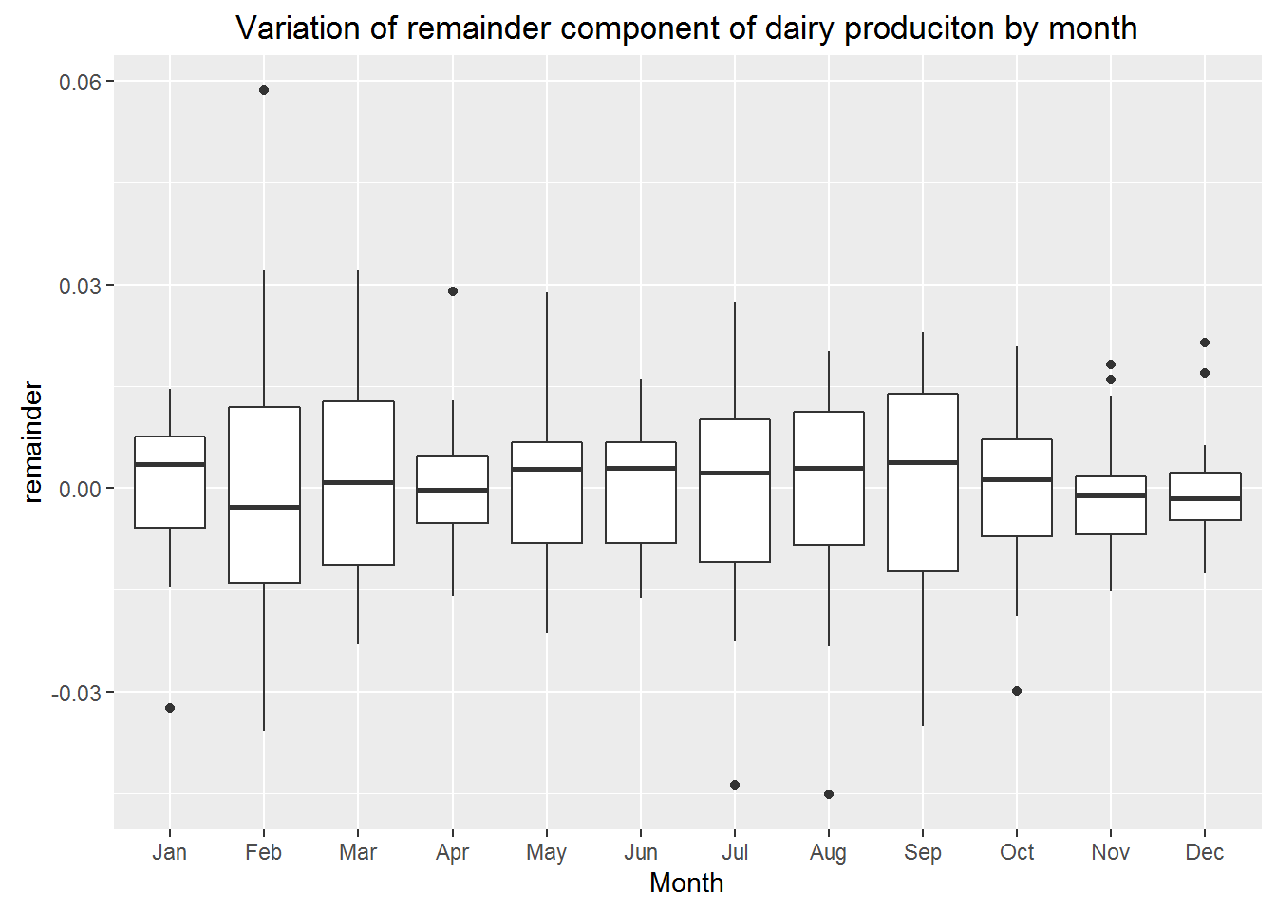
Boxplots are useful for considering stationarity
A boxplot of the remainder for each month:
Does the mean change over time?
Does the variance change over time?
Notes:
One thing you could do to check for stationarity conditions is to create a boxplot for each month or so (let’s say your time series is reported daily or something). And according to the stationarity conditions, we should be asking the questions on the left. *read Does the…* So these boxplots should look pretty much the same from month to month. You would expect some variation even for truly stationary signals. So this is not too bad. The numbers here are pretty small. The variation between these boxplots is a little big but it’s not huge. Here we binned by month. 30 days is enough to get a pretty good handle on the mean and variance of the signal within that month, so that’s ok.

Slide 75
Trend models are useful for considering stationarity
A boxplot of the remainder for each month:
Does the mean change over time?
Does the variance change over time?
Notes:
Another way to check for stationarity is to see if you can find a trend. If you can find a trend for the mean that is nonzero then you probably don’t have a stationary signal.

Slide 77
Autocovariance and Autocorrelation
“Auto” means “self”.
Autocovariance means covariance of the time series with a lagged version of itself. ACF = Autocorrelation Function
Notes:
Let’s precisely define autocovariance and autocorrelation. *Read*
*click* So this is the definition of autocovariance. Hopefully you remember what covariance of two random variables is. Autocovariance is the covariance of x at time t with a lagged version of itself, and here h is the lag.
X_t is a random variable: We don’t know what the value of the time series will be at time t, it is random. And that’s true for all time. We know how to compute the covariance of two random variables. So that’s what it is.
*click* Now autocorrelation – that’s easy, it’s just a normalized version of autocovariance so that the largest value is 1 and the lowest value is -1. So super simple. If you remember, correlation is just variance divided by something to make its value between -1 and 1. Ok good.

Slide 78
Autocovariance and Autocorrelation
If signal is weakly stationary, then variance (and std) are constant over time.
Notes:
Now, here’s a trick. *click* If the signal is weakly stationary, then the variance is constant over time, which mean the std is constant over time. So you can replace the *click* std of the lagged X with the std of X_t. So you actually get a variance on the bottom.

Slide 79
Autocovariance and Autocorrelation
If signal is weakly stationary, then variance (and std) are constant over time.
In fact, if signal is weakly stationary, autocorrelation is constant over time.
Notes:
*click 2*
And this means we can create a sample version of the autocorrelation.

Slide 80
Autocovariance and Autocorrelation
In fact, if signal is weakly stationary, autocorrelation is constant over time.
Notes:
for the variance, we can use the sample variance. For the autocovariance, we can use sample autocovariance. So that will give us sample autocorrelation. Now one last thing, to compute the autocorrelation, we use data from time h until time t, so that when we lag by h, we have the same amount of data to use in order to compute the autocorrelation.

Slide 81
Time Series Have Specific Characteristics
S&P 500
6/23/2015
6/23/2016
Notes:
And that is how this autocorrelation function plot is produced. Now you know.

Slide 83
Moving Average Models: MA(q)
Do not get confused – a moving average model is not the same as the moving average smoothing we did earlier.

Slide 84
Price of Microsoft stock
Day 1: Microsoft makes an announcement.
This affects the stock by ε that day.
Day 2: Full impact of the announcement hits the market.
This affects the stock by θ₁ε that day
Day 3: Still some effects of the announcement lingering.
This affects the stock by θ₂ε that day.
Assume no effects after Day 3.
Microsoft makes announcement every day. So what is the effect on the stock at day t?
Notes:
What influences the price of microsoft stock? Well, let’s say that on day 1, some microsoft executive makes an announcement. This affects the stock by epsi that day. So then on Day 2 the full impact of the announcement hits the market. And this affects the stock in proportion to ifs effect on day 1. So if it effects the stock by 3 points on day 1, it might hit the stock by twice that amount on day 2. Then on day 3 there’s still some residual effect of the announcement. And we’ll assume that there’s no more effect after day 3. The epsilon is like the size of the announcement. Think of epsilon being big. This is a great product that Microsoft is introducing. So big impact in the stock. If it’s a big deal then epsi is big, and then on day 2 the effect will be proportional to epsi. And same with day 3. *click* now the thing is, Microsoft makes some kind of announcement every day. So what is the total effect of the stock at day t?

Slide 85
Price of Microsoft stock
Microsoft makes announcement every day. So what is the effect on the stock at day t?
Today’s announcement
Announcement from two days ago
Yesterday’s announcement
Notes:
We have to add up the effect of the announcement today, plus the effect of yesterday’s announcement, plus the effect of the announcement 2 days ago, and then everything before that doesn’t effect us. So it looks like this *click 2* So here’s the effect of today’s announcement, yesterday’s announcement and the one from 2 days ago. And this is exactly a moving average model of order 2.

Slide 86
Moving Average Models: MA(q)
(noise)
(yesterday’s
noise)
Weighted average of current and previous noise terms.
Always stationary (this one is “order q”)
Notes:
To be more general, the value at time t from from *click* a mean mu, plus the effect of today’s announcement, which we say is today’s “noise”, plus the effect of yesterday’s announcement, which is yesterday’s noise times that multiplier because it’s yesterday, and then we could actually have noise from the past several days effecting us. And that’s it. So *click* xt is a weighted average of current and previous noise terms. *click* MA models are always stationary. This one is order q because noise from q days ago effects us. Moving average models have a short memory. They don’t care what the heck happened more than q days ago. The next day’s value depends only on the recent noise.

Slide 87
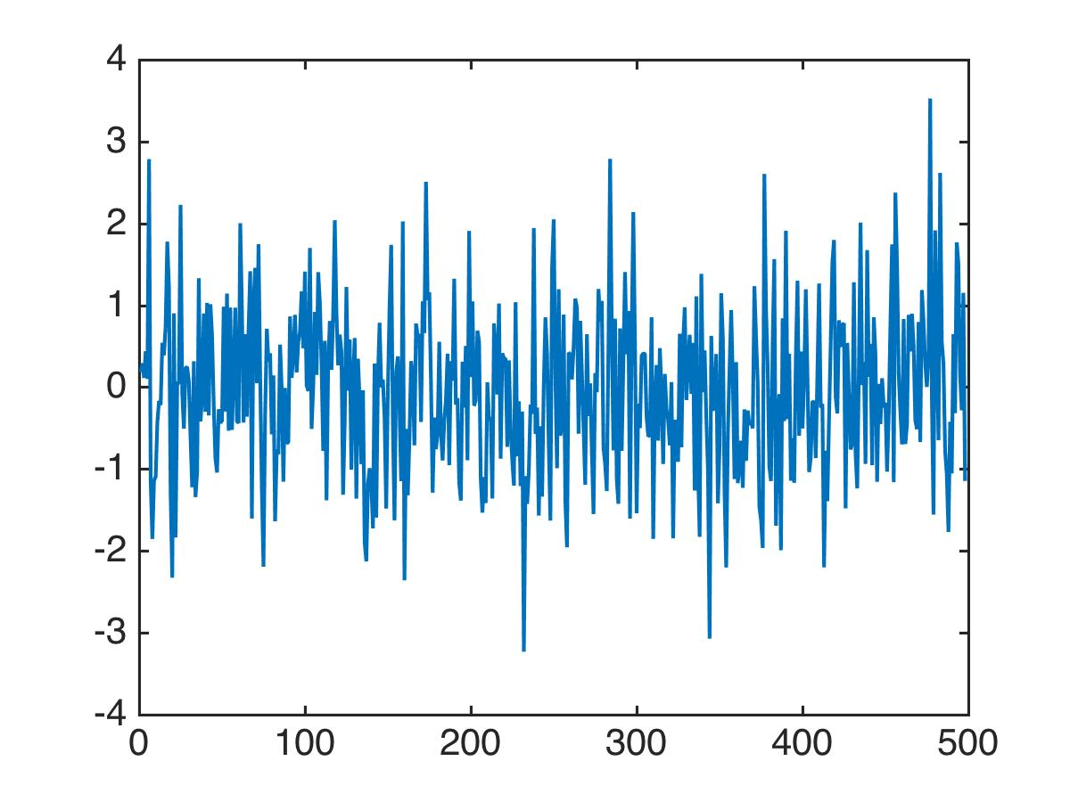
What does data from a Moving Average Model look like?
Notes:
*read*
Let’s take a very basic MA model, this one is just a constant plus some noise. The data looks like this, just noise. Actually I made the mean 0 *click*.
In fact we’ll just assume the mean is 0 from here on out. If it’s not, we can call it a trend and subtract it out and deal with it later or separately. So the mean is going to be 0. This is a very boring model because it’s just noise.

Slide 88
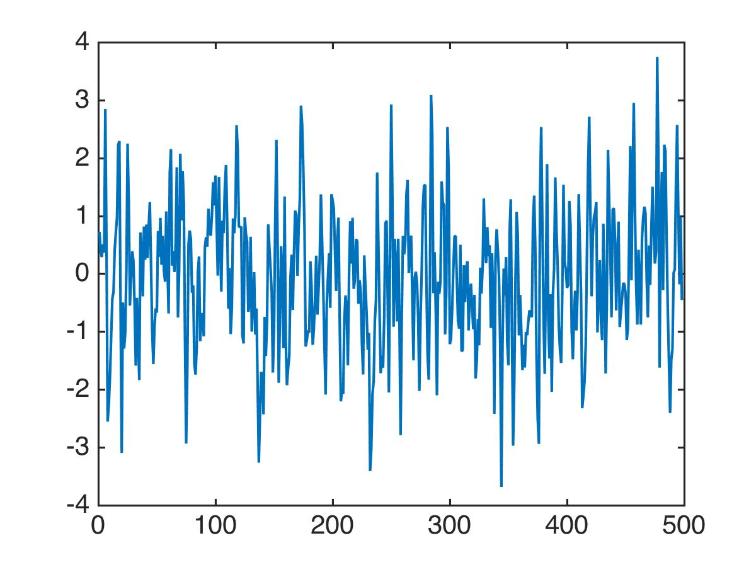
What does data from a Moving Average Model look like?
Notes:
Here’s a MA model of order 1, so this takes into account today’s announcements and then .6 of yesterday’s announcement. And the data I generated from this model looks like that. Now I don’t know about you guys, but I look at this picture, and I can see it’s stationary, but I can’t see anything else. I definitely could not have looked at that plot and said “this is a moving average model of order 1”. Anyway.

Slide 89
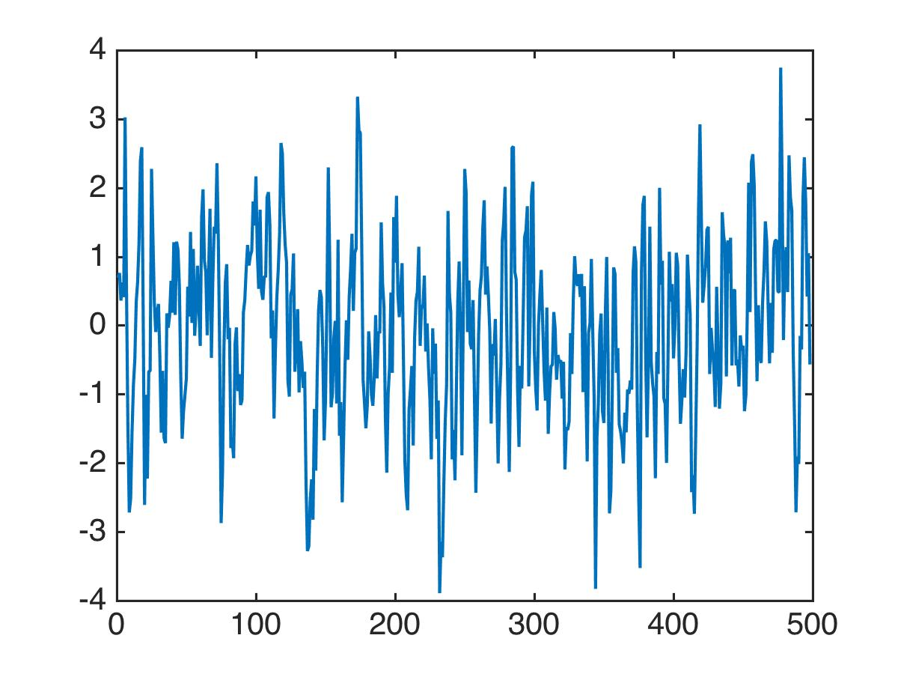
What does data from a Moving Average Model look like?
Notes:
And here’s data generated from a MA model of order 2. Clearly stationary. You know, maybe if we zoom in a bit we can see the difference between the models. Maybe we’re just looking at it from too far away. So let’s zoom in.

Slide 90
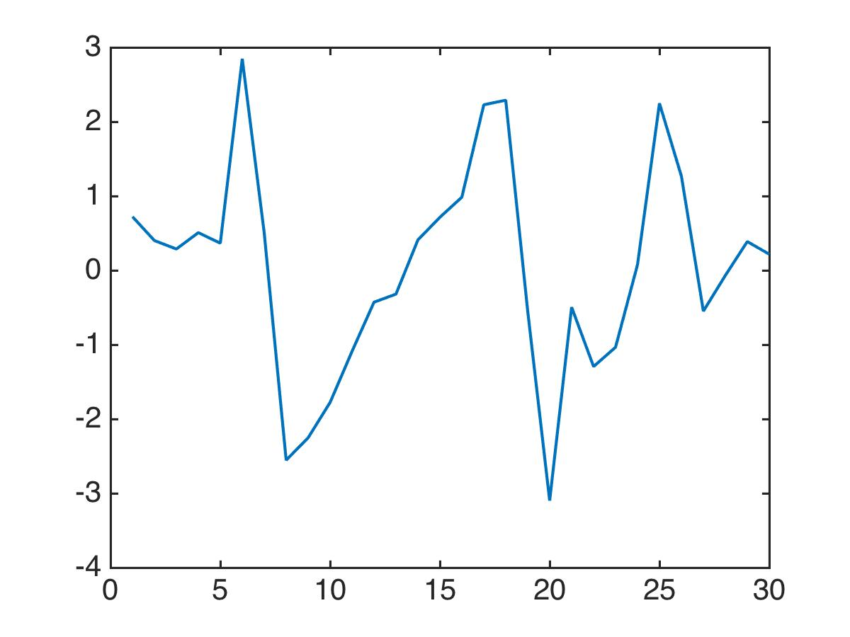
What does data from a Moving Average Model look like?
Notes:
So there’s data from this model. Order 1.

Slide 91
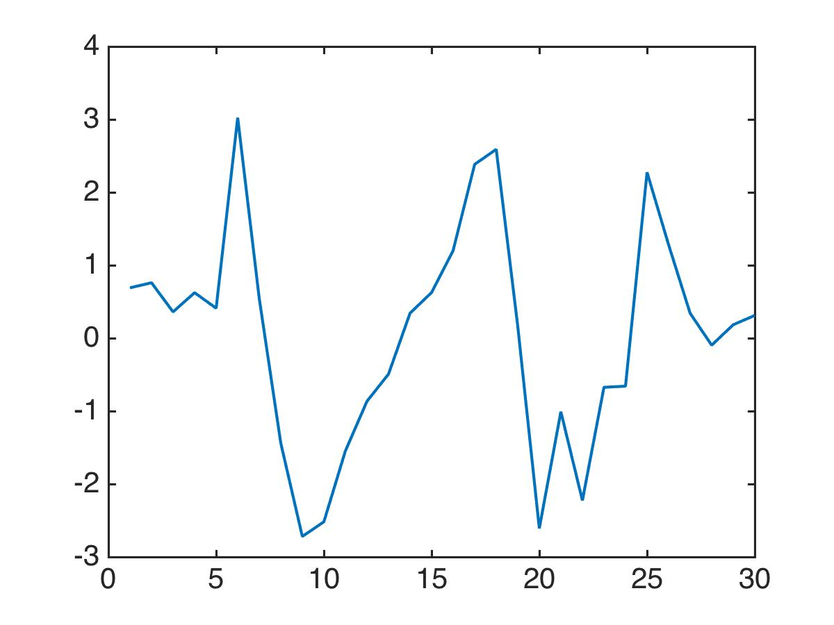
What does data from a Moving Average Model look like?
Notes:
This is from the order 2 model. I used the same random numbers by the way. But it didn’t help, I just can’t analyze time series by looking at them. So I need another tool.

Slide 92
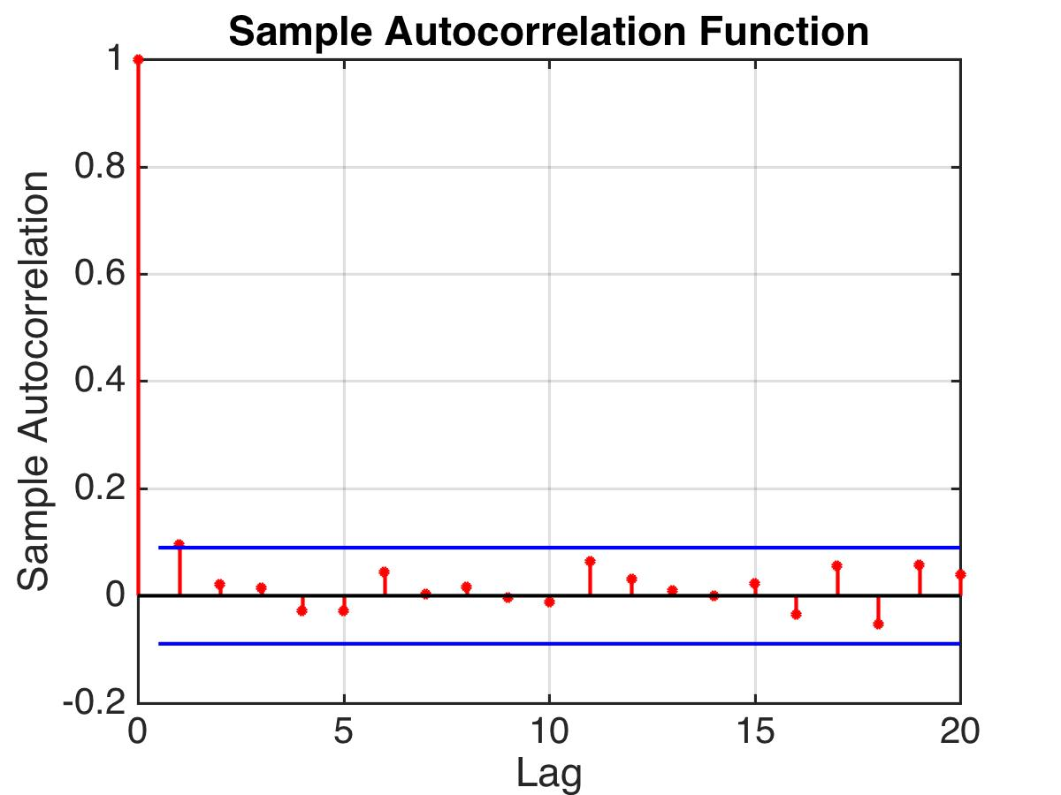
Notes:
And that tool is an autocorrelation plot. When I look at the autocorrelation of the time series, now I can actually see something. For the noise series, the autocorrelation function is of course going to be 0. Independent noise is not correlated with anything that happened in the past.

Slide 93
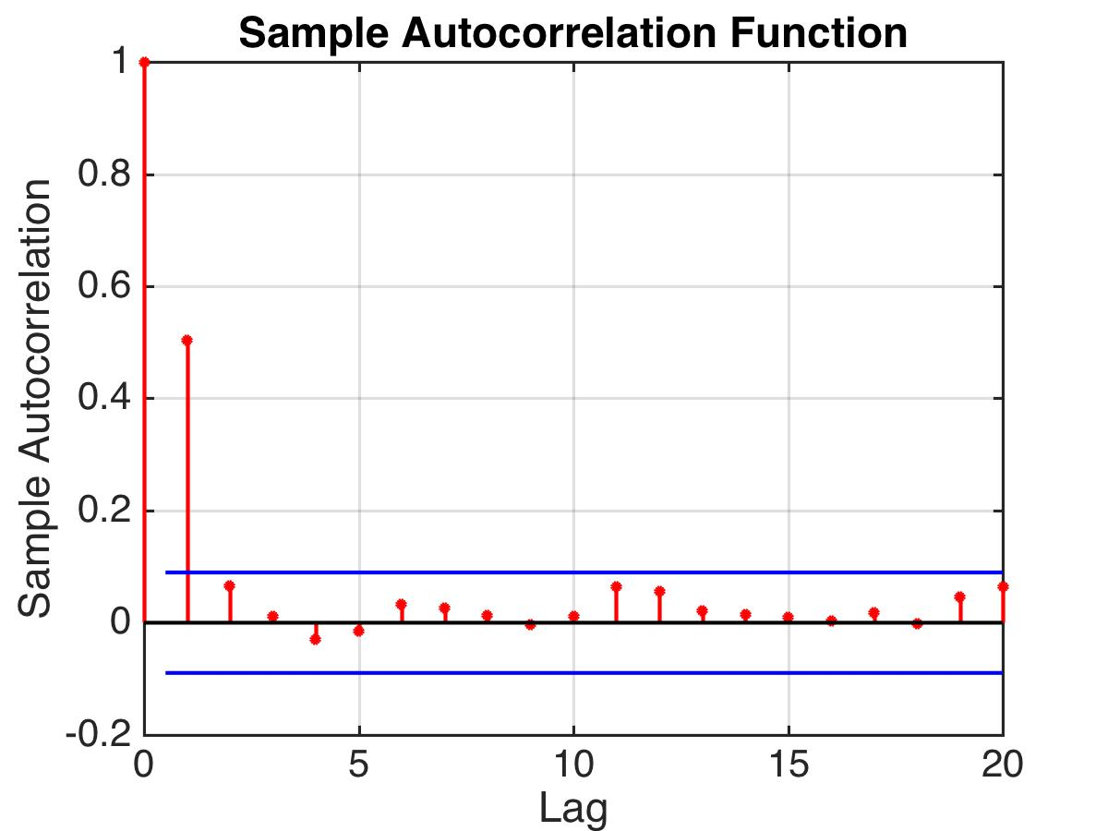
Notes:
But then if I use this model to generate the data, suddenly the autocorrelation is not 0. You can see that this model has 1 nonzero term, and that makes sense because yesterday’s values are correlated with today’s values.

Slide 94

Notes:
And this is the acf for a ma model of order 2.

Slide 95
If your data arise from a MA model of order q, the autocorrelation function will drop sharply after q.
Nice way to check if you should model data with an MA(q) model.
Notes:
Ok – so what does that mean in practice. If you have a time series, you can tell if your data arise from an MA model. You can plot an autocorrelation function and if it drops off sharply, like this one, you should be able to model it as an MA model of a particular order. *read*

Slide 96
Moving Average Model: MA(q)
Parameters need to be fit to the data. (Standard regression)
Notes:
Ok so the one remaining question is now that you have identified that you want to model the data using an MA(q) model, what are the coefficients? And you would get the answer to that by fitting the cofficients to the data using standard least squares regression. And that’s it! That’s how you determine whether data could be modeled by an MA, how you determine the order, and how you get the coefficients.

Slide 98
Autoregressive (AR) Models
Today’s value is slightly different from a combination of the last few day’s values.
Examples of AR models:
Notes:
AR models are super useful, and also really interesting. For an autoregressive model, you’d model the signal as coming from noise *click*, plus some effect of yesterday’s value, plus some effect of the value from 2 days ago, and so on. *clicks* adlib
So here’s one where the model is a bit of noise from today plus 90% of whatever yesterday’s value was.
This model is kind of cool. So, I need sleep every night, but I don’t often get what I need because I have to work so hard. So if I got only a little bit of sleep last night, I need to make it up. On the other hand, if I got a lot of sleep last night, I probably will ruin it by staying up most of the night working and I won’t get very much sleep tonight. On the other hand, it also depends on how much sleep I got 2 nights ago. If I got a lot of sleep 2 nights ago, then I don’t need as much sleep tonight even if I got some yesterday. All right so this is a nice example of an autoregressive model where the coeffciients are negative.

Slide 99
Autoregressive (AR) Models
AR(1):
Is AR(1) stationary?
Notes:
Now I have a question for you. MA models are stationary, but are AR models? Turns out I can’t tell you that. I need more information. I wrote a little piece of code to demonstrate why.

Slide 101
Is AR(1) stationary?

Slide 102
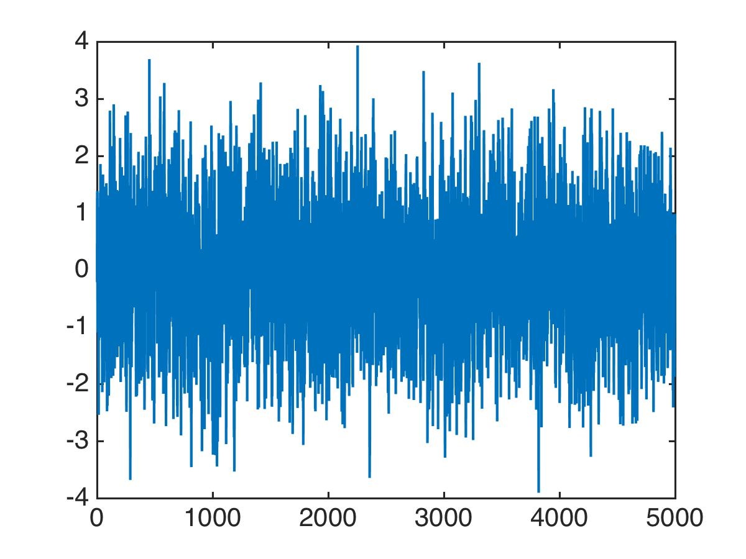
Is AR(1) stationary?
Simulation code:
Generate 50000 noise values from N(0,1) to be
For t=2 to 50,000:
(Looks stationary)
Notes:
So here’s my simulation. I generated 50 K noise values. That’s my noise. I set the first value in the series to be the first noise value. And then I simulated the rest of the series according to an AR(1) model with coefficient .5. Now take a look. *click* Remember, stationary means the mean and the variance and the autocorrelation don’t change over time. So if you see something change over time, then it’s definitely not stationary. *click* this one looks stationary.

Slide 103
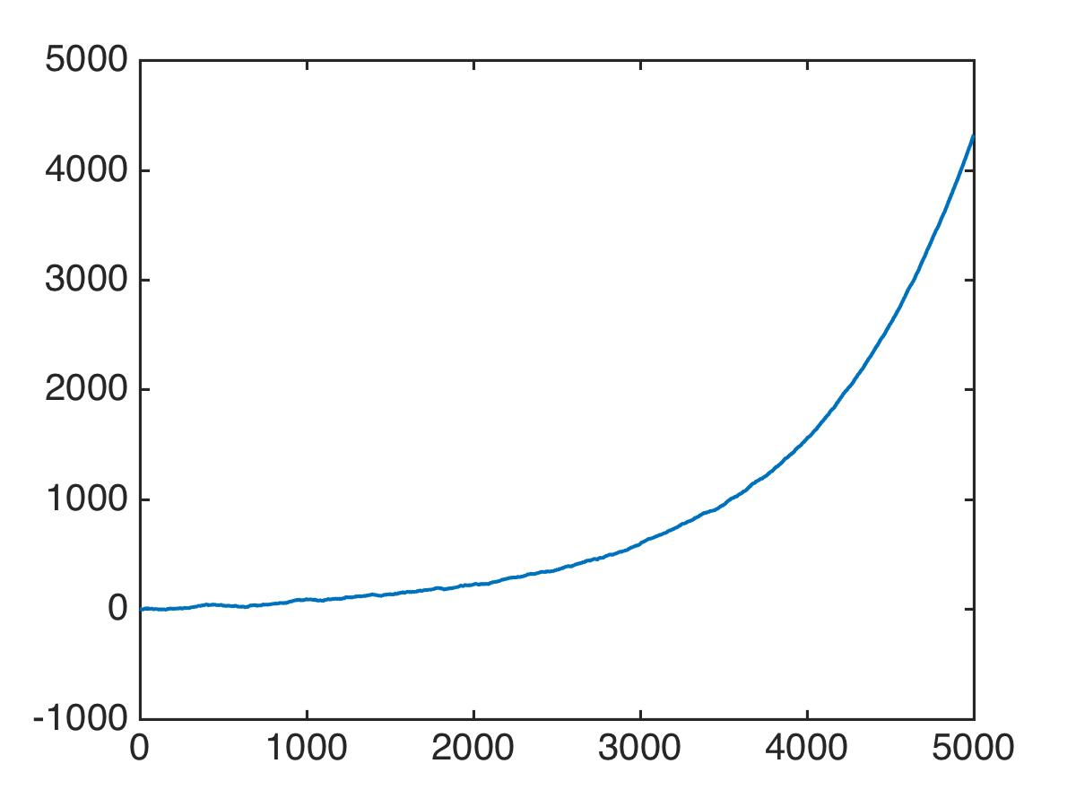
Is AR(1) stationary?
Simulation code:
Generate 50000 noise values from N(0,1) to be
For t=2 to 50,000:
Not stationary!
Notes:
Now I changed the .5 to a 1.001, and then simulated again, and let’s see what happened when I simulated *click* and that is definitely not stationary. *click* in fact I see exponential growth.

Slide 104
Is AR(1) stationary?
What happens to this series?
Notes:
That actually makes sense. You can kind of see this because if epsilon wasn’t there *click*, it’s like you’re always multiplying the previous value by something slightly bigger than 1 so of course it blows up. This is basic exponential growth here. *click* So you could predict pretty well what would happen if we made the 1.001 into a .99. Would it still blow up? *click*

Slide 105
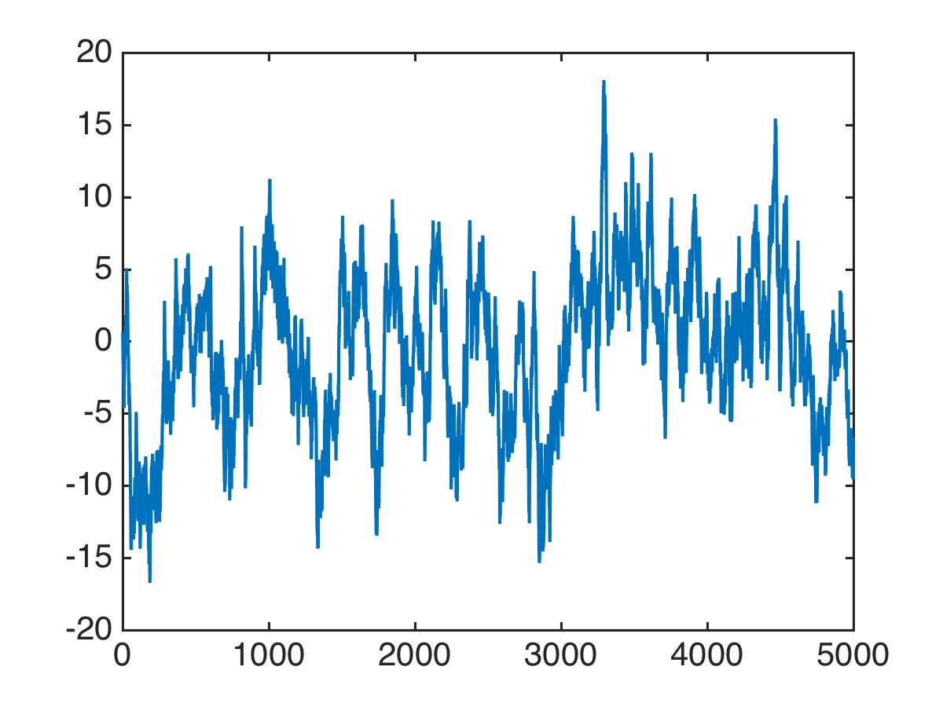
Is AR(1) stationary?
Simulation code:
Generate 50000 noise values from N(0,1) to be
For t=2 to 50,000:
(Looks stationary)
Notes:
No it doesn’t. You definitely don’t expect exponential growth. You expect something like exponential decay but there’s that noise that keeps things from going to 0.

Slide 106
AR models are not always stationary. It depends on the parameters.
Let’s look at the sample autocorrelation function for some stationary AR models.
Notes:
so just to summarize the point *read*
You can really get a sense of this from looking at the AR(1) model. If the coefficient is bigger than 1 it blows up, and if it’s less than one it is stationary. A similar condition holds for all AR models.
Now, let’s ask a different question. If we look at the AR function for a stationary model, what do you expect to see? Think about it carefully. Do you expect to see a sharp drop off like in the MA models, or do you expect something else? Well…

Slide 107
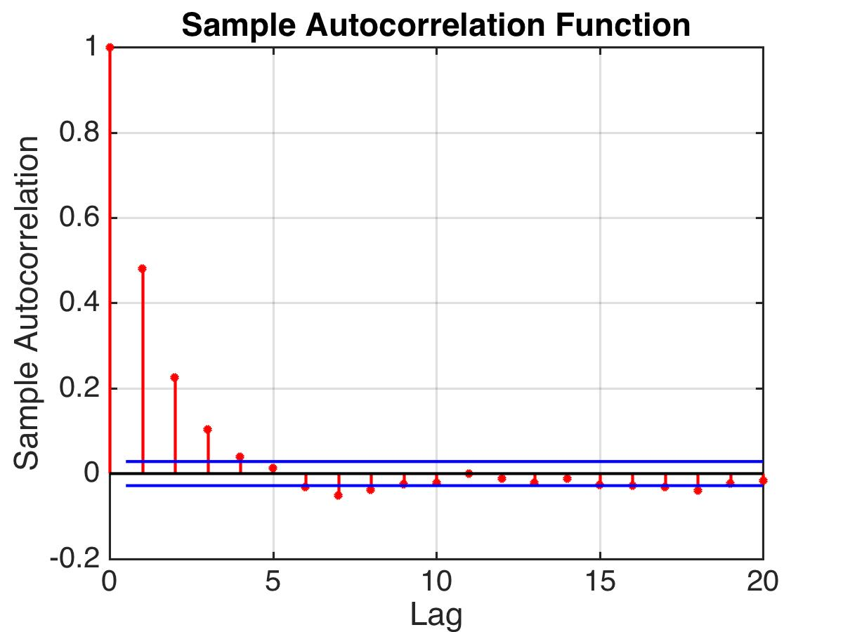
AR(1)
Notes:
Well, if it’s an AR(1) model, at time t, you expect to be correlated with the previous time, but also the time before that because t-1 is correlated with time t-2, and then time t-2 is also correlated with time t-3, so you’re correlated with that, and so you see correlations for a while. *click* In fact you see exponential decay here.

Slide 108
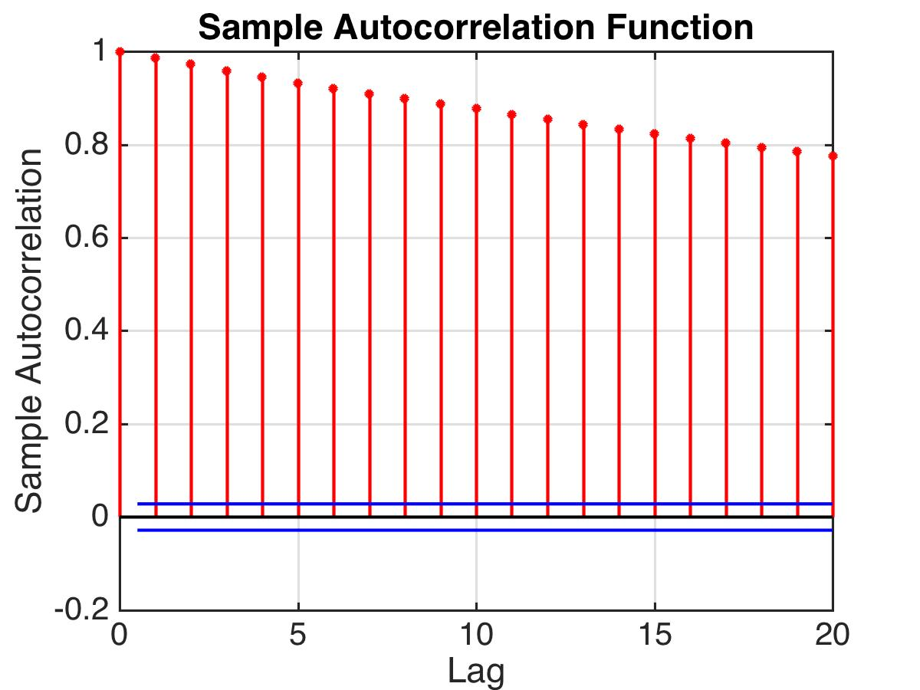
AR(1)
Notes:
And then what about if the coefficient is .99? I think it makes sense that we still exponential decay. *click* however, its very slow. Because the coefficient is .99, the value at t is *very close* to the value at time t-1, and that’s *very close* to the value at t-2, and so on, so the correlations hang around for a long time.

Slide 109
AR models are not always stationary. It depends on the parameters.
Let’s look at the sample autocorrelation function for some stationary AR models.
It has exponential decay.
For an AR(q) model, how can we tell what q is?
Notes:
Ok back to this. The ACF has exponential decay. *click* So that’s bad right? That means you can’t tell for an AR model what the order is by looking at the autocorrelation function. So *click* for an AR model, how are you going to determine the order? Whether it’s an AR(1) model or an AR(17) model, the acf has exponential decay. So that means the ACF doesn’t tell you how to figure out what the right model is. For the MA model you could read it off the ACF plot, you just look for a sharp cutoff. But here you can’t do that. We have got to find another way. We can’t look at the ACF plot. What would be nice is if we had a plot like this:

Slide 110
Nice if this were correlation between X_{t} and X_{t-2} removing effect of X_{t-1.}
This is what partial autocorrelation does.
Notes:
If you could actually look at this plot and tell me the effect of what happened two days ago on today that would be great. Removing whatever happened yesterday. In other words, I want to know whether the amount of sleep I got two days ago influences the amount of sleep I’m going to get tonight or not? Is it only yesterday’s sleep that determines today’s sleep? *click* right, it would be nice if this were the correlation between x and it’s lagged version, removing the effect of everything in between. *click* read

Slide 111
Partial Autocorrelation
Notes:
and that is what the partial autocorrelation is going to tell us.

Slide 112
Let’s look at the sample autocorrelation function for some stationary AR models.
It has exponential decay.
For an AR(q) model, how can we tell what q is?
Notes:
So we will have a plot like this, and that’s what the partial autocorrelation will tell us.

Slide 113
Nice if this were correlation between X_{t} and X_{t-2} removing effect of X_{t-1.}
This is what partial autocorrelation does.
Notes:
If you could actually look at this plot and tell me the effect of what happened two days ago on today that would be great. Removing whatever happened yesterday. In other words, I want to know whether the amount of sleep I got two days ago influences the amount of sleep I’m going to get tonight or not? Is it only yesterday’s sleep that determines today’s sleep? *click* right, it would be nice if this were the correlation between x and it’s lagged version, removing the effect of everything in between. *click* read

Slide 114
Partial Autocorrelation
The partial autocorrelation of X_{t} and X_{t-u} is their correlation that is not accounted for by lags 1,..,u-1.
E.g., Effect of sleep 2 nights ago on tonight’s sleep:
Notes:
*click read* and we write the partial autocorr this way for lag u: *click* The correlation between Xt and it’s lagged version, taking into account everything in between.
*click* So the effect of sleep 2 nights ago on tonight’s sleep looks like this, it’s the partial autocorrelation of lag 2. It’s the correlation between tonight’s sleep and 2 nights ago’s sleep, that is not accounted for what happened last night.
The way of computing this is really complicated. So bare with me for a minute. I’m just going to work it out for the sleep example to keep it simple.

Slide 115
Partial Autocorrelation
Do the following: predict correction to X_{t} from X_{t-1}:
Also predict correction to X_{t-2} from X_{t-1}:
Notes:
Let’s start with beta1. Beta1 is the notation for the correlation between Xt and it’s 1step lagged version. To compute the partial autocorrelation, *click* we will
do the following for all time. We’ll predict Xt from Xt-1 using just the fact that it’s correlated with t-1.*click* And here beta1 is the correlation between xt and it’s 1 step lagged version.
Then we’ll also predict Xt-2 from Xt-1 again using beta1. Remember that autocorrelation doesn’t change over time if it’s a stationary time series, so if *click* beta1 is the correlation between t-2 and t-1, then it’s also the same as the correlation between xt and xt-1, so that’s good.
Now for the partial autocorrelation *click*. That is the correlation between the prediction error at t and the prediction error at t-2. *click*

Slide 116
Partial Autocorrelation
Do the following: predict correction to X_{t} from X_{t-1}:
Also predict correction to X_{t-2} from X_{t-1}:
This is what I can’t explain about X_{t-2} from X_{t-1}.
Can I use it to predict
what I can’t explain about X_{t} from X_{t-1} ?
Notes:
*click* this thing here, this is
*read*– this is the essence, if you will, of two days ago.
Can I use it to predict *click*
the essence of today? In other words, can I use it to predict what is unexplained by yesterday’s value? That’s what the partial autocorrelation tells you. It’s the correlation between the prediction error at time t and the prediction error at time t-2 where we’re allowed to use any times in between to make predictions. I’ll show you the more general version in a moment, but let’s go back to the data for a minute.

Slide 117
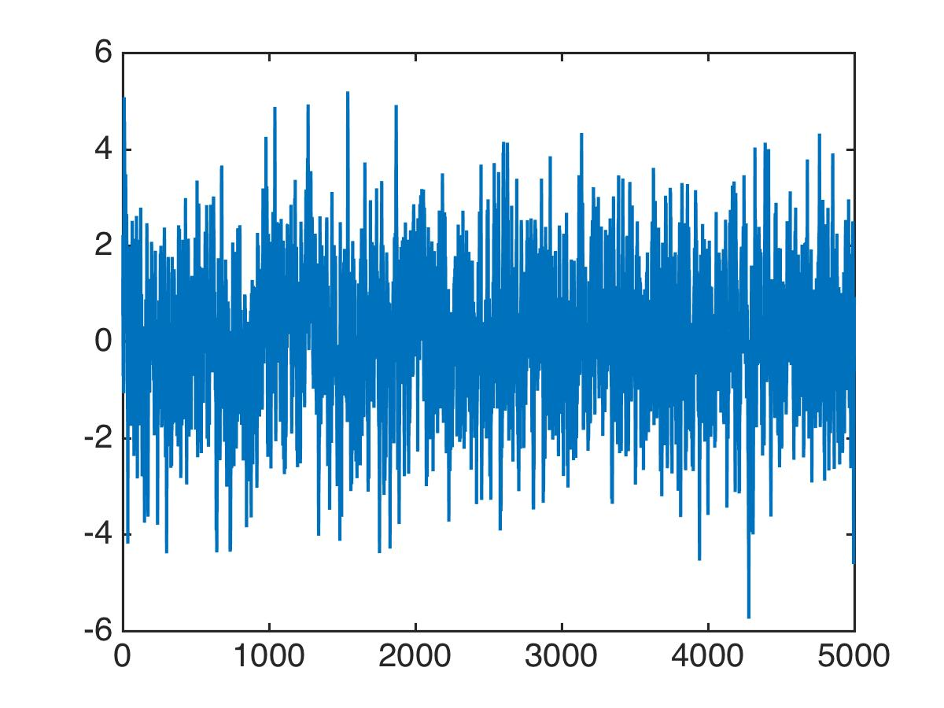
Partial Autocorrelation
Data from model:
Notes:
So let’s say I have this model up here, and I generate some data from it, there *click*

Slide 118
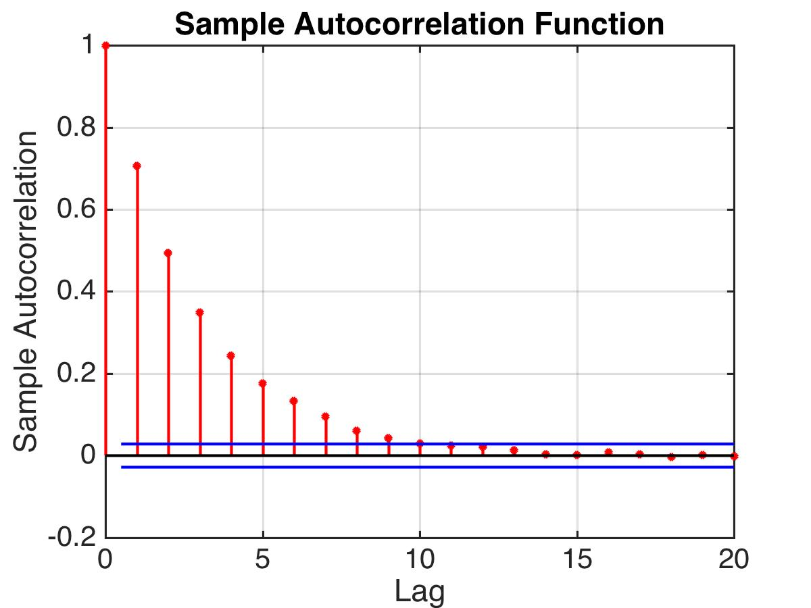
Partial Autocorrelation
Sample autocorrelation doesn’t tell me anything.
Notes:
Then a compute the autocorrelation function. And it doesn’t tell me anything, other than the fact that it’s not a pure MA model. I see exponential decay, so fine, we think it’s an AR model. But we don’t know what order it is unless we cheat and look at the equation.

Slide 119
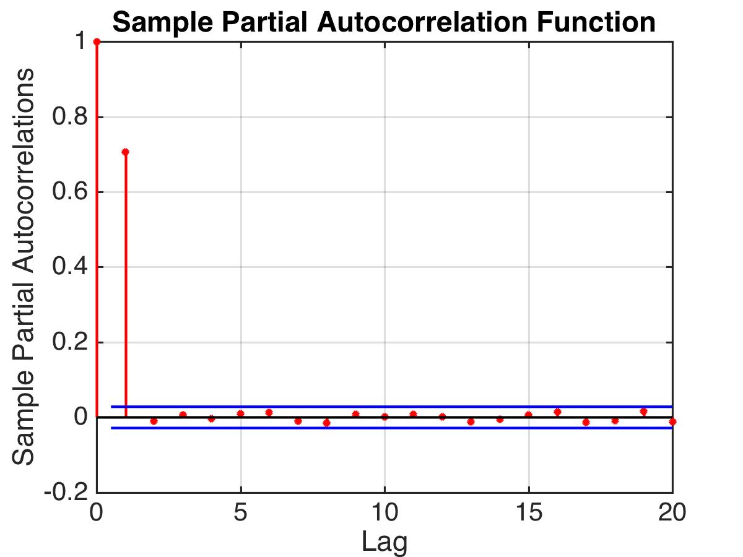
Partial Autocorrelation
Partial autocorrelation tells me a lot!
Notes:
But if we look at the partial autocorrelation function *click* then it tells me *click* a lot. In fact it tells me exactly what I need to know – that this is an AR(1) model. There’s 1 term in the model, because there’s one nonzero term in the partial autocorrelation function. Now we can go to the more general version.

Slide 120
Partial Autocorrelation
Notes:
The partial autocorrelation for lag u is the correlation between the prediction error at time t and the prediction error at time t-u, where we are allowed to explain xt and xt-u using everything in between *click 2*. So we get to use all the lags in between to predict xt and xt-u. And that’s what it is! So how do I get those beta’s? In the lag 2 case I just had 1 beta and I used the correlation. But here I have a lot of betas. And we’ll get those using the method of least squares. Let’s walk through that more slowly.

Slide 121
Partial Autocorrelation
Do the following: use a linear model to predict X_{t} from lags:
Use least squares to get coefficients:
Use a linear model to predict X_{t-u} from lags:
(The coefficients are the same because correlations don’t know whether we’re going forward or backwards in time.)
Notes:
*click* First, we’ll use a linear model to predict xt from the lags. *click* We’ll use least squares to get the coefficients. *click* And there’s the thing we minimize. *click*
Then *click* we’ll use a linear model to predict Xt-u from the lags, *click* like that. Now the coefficients are the same, as the ones up here. *click* and that’s because least squares is all about correlations, and correlations are not directed, they don’t know whether we’re going backwards or forwards in time. Which is just a bit more convenient. Anyway, so there it is.

Slide 122
Partial Autocorrelation
Describes unexplained part of X_{t} from unexplained part of X_{t-u}, where explanations come from all lags in between.
Notes:
The partial autocorrelation. And just to remind you of the intuition behind it, it *Read*

Slide 123
AR models summary
AR models are not always stationary. It depends on the parameters.
The autocorrelation function for stationary AR(p) models.
It has exponential decay.
The partial autocorrelation for stationary AR(p) models
It has a strict cutoff at (p).
Notes:
All right, let’s summarize what we learned for AR models. read until *it has a strict cutoff at p and that’s how I know what the order of the AR model is.

Slide 124
ARMA models

Slide 125
Auto-Regressive Moving Average: ARMA (p,q)
AR(p)
MA(q)
If you know p and q, can do regression to get all parameters.
But how do you know them?
Pure MA models have a sharp cutoff for the autocorrelation function.
Notes:
An ARMA model has an AR part and an MA part. Just like that *clicks*
The price of the product today depends on yesterday’s price, the day before’s price, and so on, that’s the AR part, but it also depends on the announcements about the company’s welfare over the past few days. That’s the MA part.
*click* Now if you know the order p for the ar part and you know the order q for the ma part, you can use regression to get all the phi’s and all the theta’s. But how do you know them? *click* Well, you can look at the acf. *Click*

Slide 126
Pure MA model
Notes:
Right, here’s a purely MA model, and there’s a strict cutoff on the ACF.

Slide 127
Auto-Regressive Moving Average: ARMA (p,q)
AR(p)
MA(q)
I just have data. How do I know what I’m dealing with?
Pure MA models have a sharp cutoff for the autocorrelation function.
Pure AR models have a sharp cutoff for the partial autocorrelation function.
If both the autocorrelation and partial autocorrelation have slow decay, we’ll need both AR and MA terms.
Notes:
read

Slide 128
Differencing

Slide 129
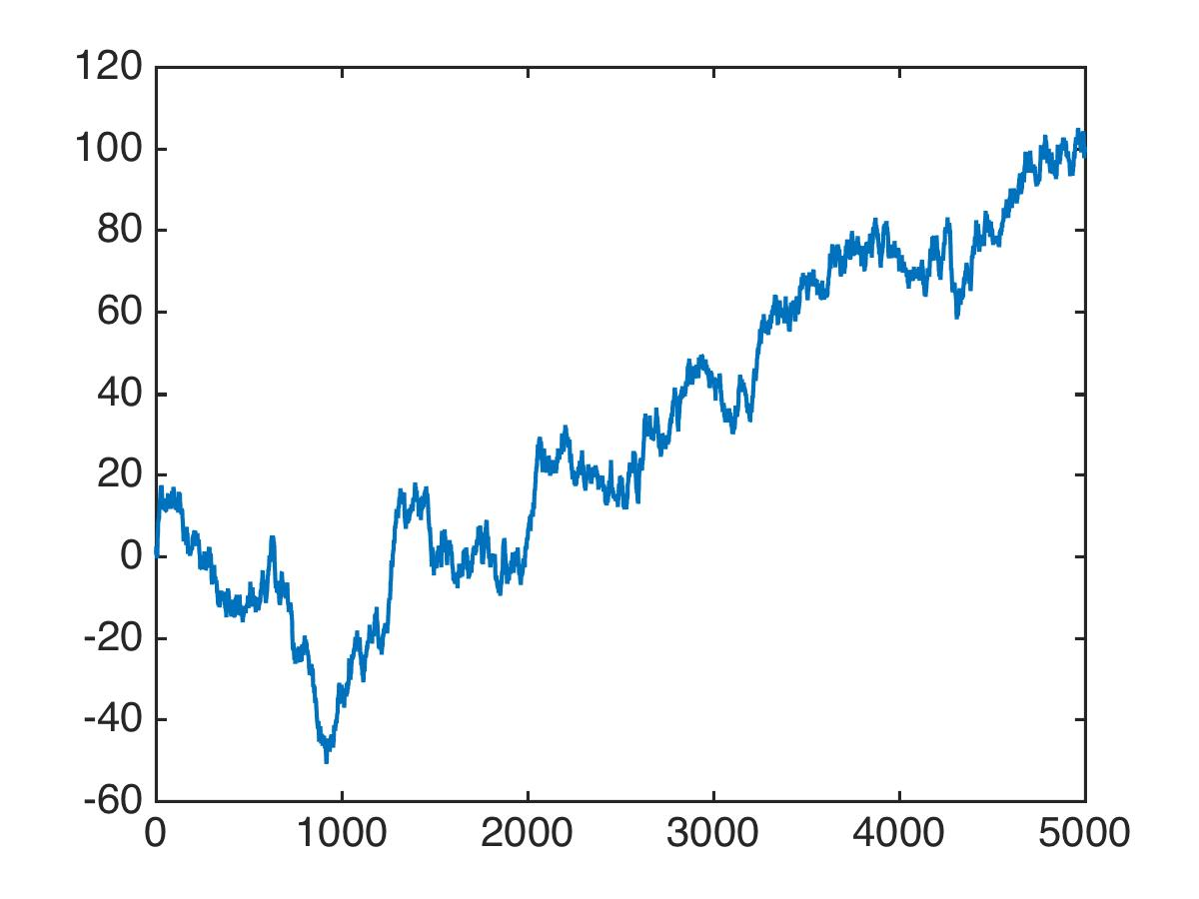
Differencing and why it’s a powerful tool
A random walk.
Noise
Yesterday
Not stationary
Notes:
Let’s start by talking about random walks. How do you do a random walk. To do a random walk, we look at the position we were in yesterday, and we take a random step. Call that step epsilon. And that’s the position we’re in today. So that’s how you do a random walk. So if I simulate a random walk, it looks like this. *click* Now, Is that stationary? clearly not, it’s definitely not mean 0. So it’s not stationary *click* And so this of course means we can’t use any of the tools we discussed. We can’t use moving averages, can’t use autoregressive models, so are we stuck? Well, it’s not quite true that we can’t use all our tools. There’s just a little trick that we need in order to transform our random walk into something we can actually study. And that trick is called “differencing”

Slide 130
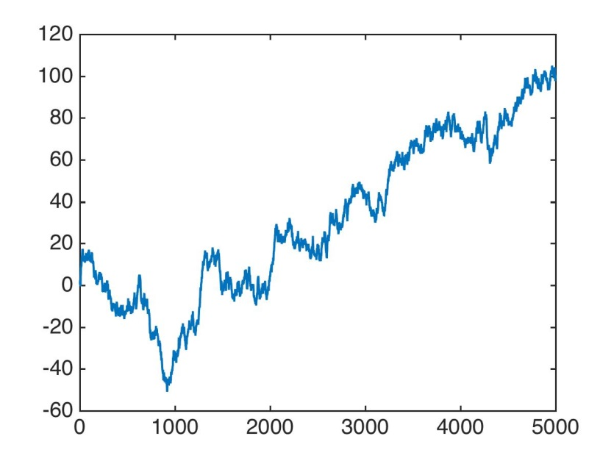
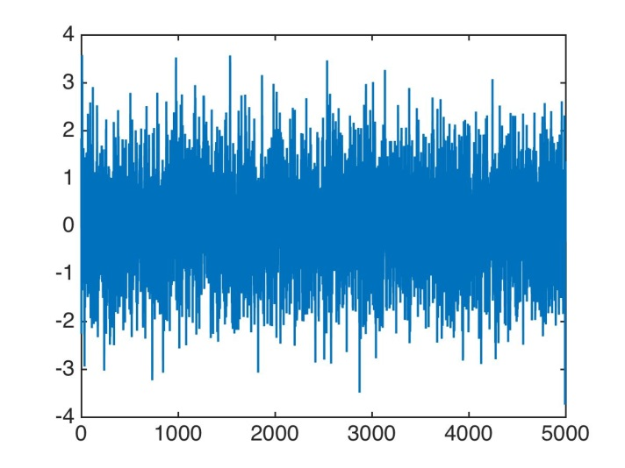
Differencing and why it’s a powerful tool
Compute the “difference series”:
This series is stationary.
So if you have data like this:
Compute the difference series and model it.
Notes:
Ok so what’s differencing. Differencing is when you compute the difference of today and yesterday. *click* Like that. *click*
If this is truly a random walk, then when we take the difference of the series *click*, then we get just the noisy step we took. And that series is just noise, so it’s stationary. *click* So, what just happened here. We had a series that *Wasn’t* stationary, and now transformed it into a series that is stationary, and we can use all our cool tricks. *So*, *click* if you have data like this *click* then you might want to compute the difference series *click* and model that *click* because it’s stationary.

Slide 131
Differencing and why it’s a powerful tool
An integrative moving average
Not stationary
Random walk terms
MA(1) term
Stationary
Notes:
here’s another example. It’s called integrative moving average. It starts with a random walk . So you know right now that it’s not stationary. And then I go and add an MA1 term to it. *click 2* So it looks like a moving average, and it looks like a random walk. But no matter how you look at it, it’s not stationary. *click* But if you look at the difference series *Click*, that thing *click* is just an MA(1) series. And all moving average series are stationary. So this is *click* stationary*.

Slide 132
Differencing and why it’s a powerful tool
We can use differencing to help us model non-stationary time series.
Notes:
So basically, the bottom line is *click read* If the difference series is stationary, we’re in business.

Slide 133
Differencing part 2
Notes:
In the last part you learned that differencing once can help you turn a nonstationary time series into a stationary one. But what I showed you is just the tip of the iceberg.

Slide 134
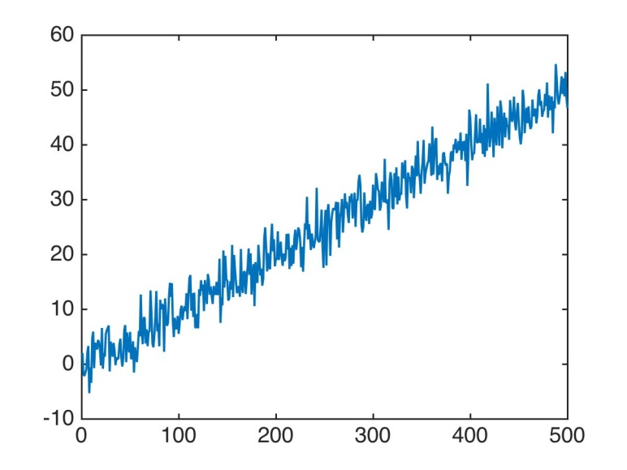
Differencing and why it’s a powerful tool
Say there’s a linear trend + stationary series
Stationary
Notes:
Let’s say we have a linear trend plus a stationary series. So when you plot it, you get something like this *click*, so it’s a linear trend, plus some stationary signal that looks like noise here. So it’s not stationary. Let’s take the difference series *click* So we’ll just write it out like that, I just plugged in the formula in here for t and t-1. Then I simplify a little bit. I can get rid of the beta0 terms and I move things around and I’m left with that *click* then I can get rid of the beta1t terms, and I’m left with that *click*. And this thing – is a constant, beta1 plus the difference series for the stationary signal, which is stationary. So guess what, we just turned a linear trend, a *huge* trend, into something stationary! Very cool. Not very surprising if you think about it carefully. This is the same way that when you take the derivative of a line you get a constant. When you take the difference series, it’s just like taking a derivative. it’s like a discrete derivative.
Now for a drop of notation. *click* The thing on the left we’ll call delta x. And the thing on the right we’ll call delta Z.

Slide 135
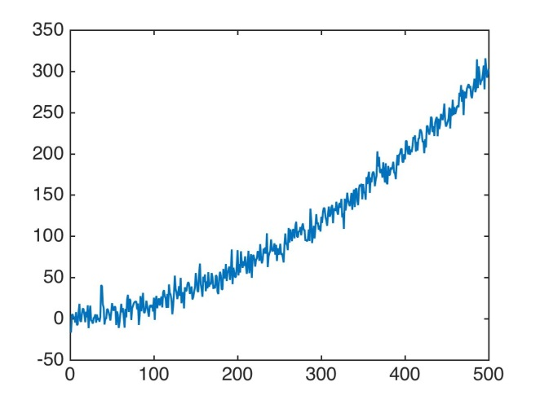
Differencing and why it’s a powerful tool
Say there’s a quadratic trend
Linear trend + Stationary
Stationary
☺ See previous slide
Notes:
Now, let’s go even one step further. *click* Let’s say you have a *quadratic* trend. *click* plus something stationary, like this. Now take the difference series. *click* And it looks like that. *click* simplify by removing the beta0s that cancel, and the beta1t’s, then you get this *click* then cancel out the t^2 terms, and you end up with this. *click*. Now does that look familiar? It should because we analyzed this on the last slide. It’s a linear trend plus a stationary series. *click4* And we know how to deal with that, by taking another difference. It’s the same thing here, when you take the derivative of a quadratic, it’s linear. Then you take the derivative again, it’s a constant. And I’ll put in the notation for that *click*. So 2 discrete derivatives, gives you a constant plus a stationary series.

Slide 136
Differencing and why it’s a powerful tool
Allows you to use techniques for stationary time series to model nonstationary series.
Higher order trends turn into stationary models through repeated differencing.
Notes:
So now you know why differencing is a powerful tool. *Read*

Slide 138
ARIMA models
Notes:
Finally we get to arima models. Arima models are different than arma models in that they are named after a guy. Called Mr. Arima. He’s a sweet little old man and the last time he came to visit, I got a big kiss on the cheek and I was thrilled! Actually I’m kidding.

Slide 139
ARIMA models – Auto-Regressive Integrated Moving Average
If a difference series is an ARMA model, then it’s an ARIMA.
order of differences
order of AR
order of MA
Notes:
Arima is Auto-Regressive Integrated Moving Average. The way it’s defined is that it’s series where when you take the difference series, you get an ARMA model. Even if you have to take the difference of the difference of the difference and do that a few more times, if you eventually get to an ARMA model, then the original series is an ARIMA model. *click* The way we write it is like this. The original series is X, and then we take the difference d times to get Y. Now in order for X to be an arima model, Y has to be an ARMA model. *click* so let’s write Y as an arma model. So here are the Ar terms, and here are the MA terms.
In other words, if the difference series is a purely MA model, or a purely AR model, then it’s an ARIMA model. Or if the difference series is a mixture of both MA and AR, then it’s still ARIMA. *click* and the way we notate an ARIMA model is like this. We have 3 parameters, d, p, q that tell us *clicks read*

Slide 140
ARIMA
As long as the difference series of any order is an ARMA model, you’re in good shape.
Difference series can be computed easily.
You can use the autocorrelation function to determine the order of a purely MA model, or the partial autocorrelation to determine the order of a purely AR model.
Notes:
All right, now some good stuff to know about ARIMA models. *click1* *Read* So why is that? because *click read* You can just keep taking differences and testing to see whether you have an arma model.
You take the difference, then you can try to model it as an arma, if it’s not stationary, you could take the difference series again! You’re at d=2. And then if that’s not stationary, you could take the difference series again, then you’re at d=3. And so on. *click*
If you don’t have this, you may be in for a little fiddling. But at least you have a really good starting point which may actually tackle the whole problem in many cases.

Slide 141
EWMA

Slide 142
EWMA: Exponentially Weighted Moving Averages SES: Simple Exponential Smoothing Model
Arguably the most widely used times series model for business applications
ARIMA(0,1,1)
Notes:
Super powerful tool *click* *read* *click* and it’s a special case of an arima model, an arima 0, 1, 1 model.
so its an arma model since d=0, with one ar term and one ma term.

Slide 143
EWMA: Exponentially Weighted Moving Averages SES: Simple Exponential Smoothing Model
Makes predictions like this:
This is a mixture of what we predicted and the previous value.
Notes:
*read, clicks* it’s a mixture of what we predicted at time t-1 and what actually happened at time t-1.

Slide 144
EWMA: Exponentially Weighted Moving Averages SES: Simple Exponential Smoothing Model
Makes predictions like this:
The last forecast is adjusted by its error
Notes:
Let’s simplify this a little bit to get some intuition. *click* So here just expanding it out. And then I’m collecting terms that have alpha in them, *click* There like that. Now *click* I’m defining et-1 to be the prediction error at time t, it’s just the truth minus what we predicted. And then plug that back in and I get *click* that the estimate for Xt is just what I predicted for Xt-1, plus some adjustment times the prediction error. *click* So that’s a nice bit of intuition, that the value at time t comes from a mixture of what we thought would happen yesterday and a bit of yesterday’s error.

Slide 145
EWMA: Exponentially Weighted Moving Averages SES: Simple Exponential Smoothing Model
Makes predictions like this:
X
t
The last forecast is adjusted by its error
Notes:
So how do we make predictions using this model? Let’s say we picked alpha, or fitted it. *click2* now this is what happened at time t-1. But the truth was quite a bit higher. So we made an error. *click2* Then at time t we make a prediction that combines what we thought would happen last time, with the error we made. So we get a prediction that looks like this. *click2* So this is nice - if the prediction was too low last time, then it gets pulled up by a fraction of whatever the error was. If the prediction was too high, then the next prediction gets pulled down a bit.

Slide 146
EWMA: Exponentially Weighted Moving Averages SES: Simple Exponential Smoothing Model
Makes predictions like this:
ARIMA(0,1,1)
Notes:
Let’s play around with the EWMA model just for some more intuition. *click* Take the formula, and then we’ll add 0 in disguise, *click* which are those two terms right there. And then *click* we’ll collect terms, so we have the xt-1 terms just combining to be Xt-1, and then we’ll collect the other two terms, which are both multiplied by 1-alpha. *click* Again we have the error being the truth minus the estimate of it. And plugging that back in we get this *click* . So its an arma model with one ar term and one ma term. *click* and we can write it just like this.

Slide 147
EWMA: Exponentially Weighted Moving Averages SES: Simple Exponential Smoothing Model
Arguably the most widely used times series model for business applications
ARIMA(0,1,1)
Notes:
So just to summarize, we’ve been talking about exponentially weighted moving averages. *read1* it’s a special case of the arima model, an arima 0,1,1 model. All you need to do is pick a value of alpha and you can immediately use it for forecasting. You just take the previous prediction, and add it to alpha times the prediction error at the last time, and that’s your forecast.
This has been really helpful to my students – we used it in one of the data mining competitions and it really helped in producing good forecasts. It’s a really useful tool, and now you know it.
%Used it in a data mining competition to forecast the click through rate for customers on Yahoo!’s website. This was one of several key ingredients that we used to perform well in that competition.

Slide 149
Lowess/Loess Regression
Step 1: Define the window width m. We will use the m nearest neighbors that are within the window to do local regression.
Step 2: Choose a weight function. It should give higher weights to nearer points.
Step 3: Do regression. Use polynomial terms. Use the weights from Step 2.
Notes:
The distance is normalizes so that the distance to the edge of the window is 1. All the distances are scaled.
http://polisci.msu.edu/jacoby/icpsr/regress3/lectures/week4/15.Loess.pdf

